Slide 1




Project Overview
ECO-SYNC
TEAM YOUR WORST NIGHTMARE

Slide 2
”STOP DREAMING
AND START
DOING”

Slide 3

Public Home Screen

Slide 4

Login Page For Users

Slide 5
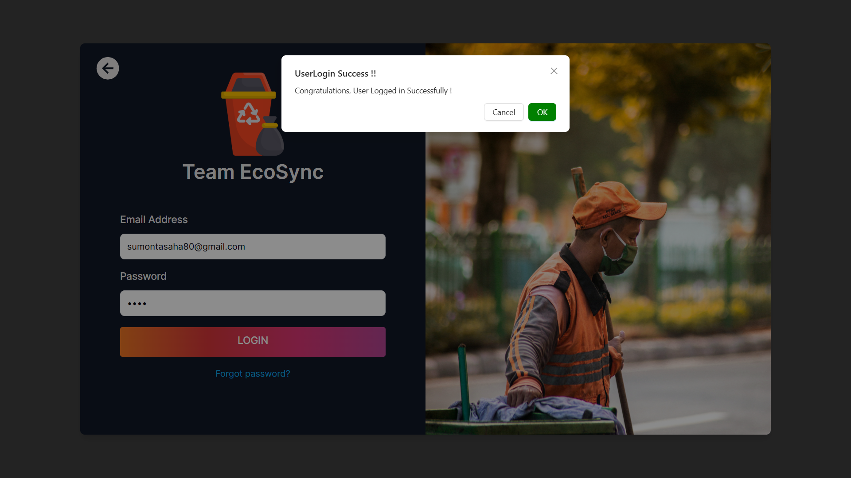
User Logged in Successfully

Slide 6
USER ROLE : ADMIN
Perspective from a System Admin

Slide 7
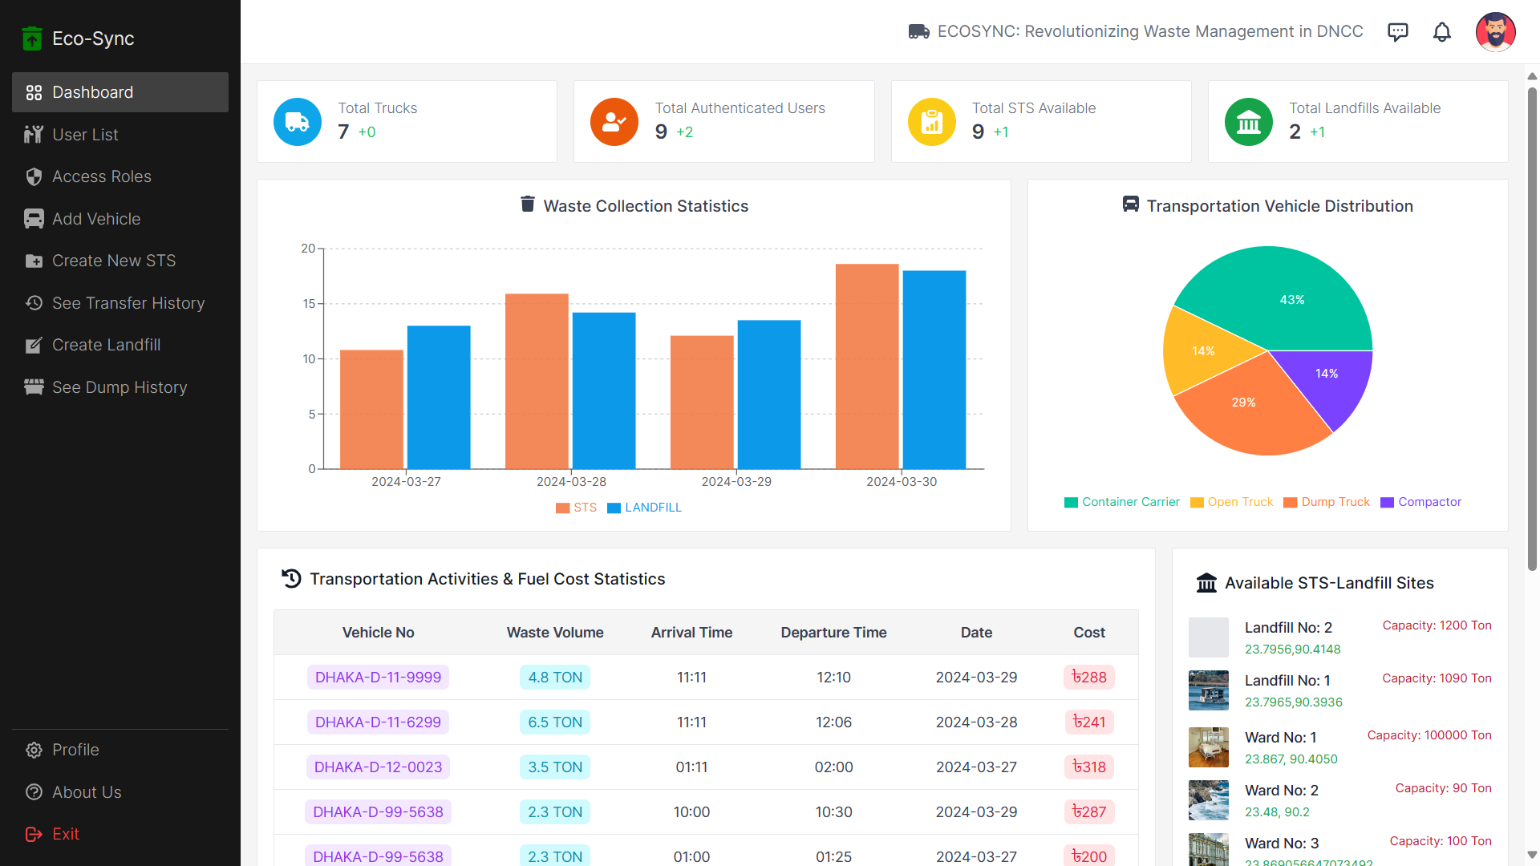
Dynamic Dashboard

Slide 8
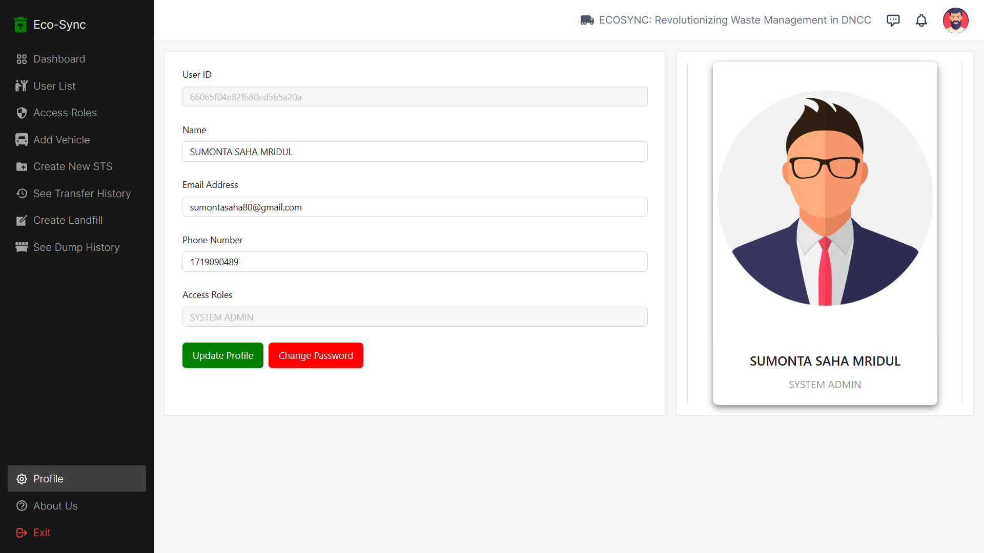
Profile Page : Can Update Information and Password

Slide 9
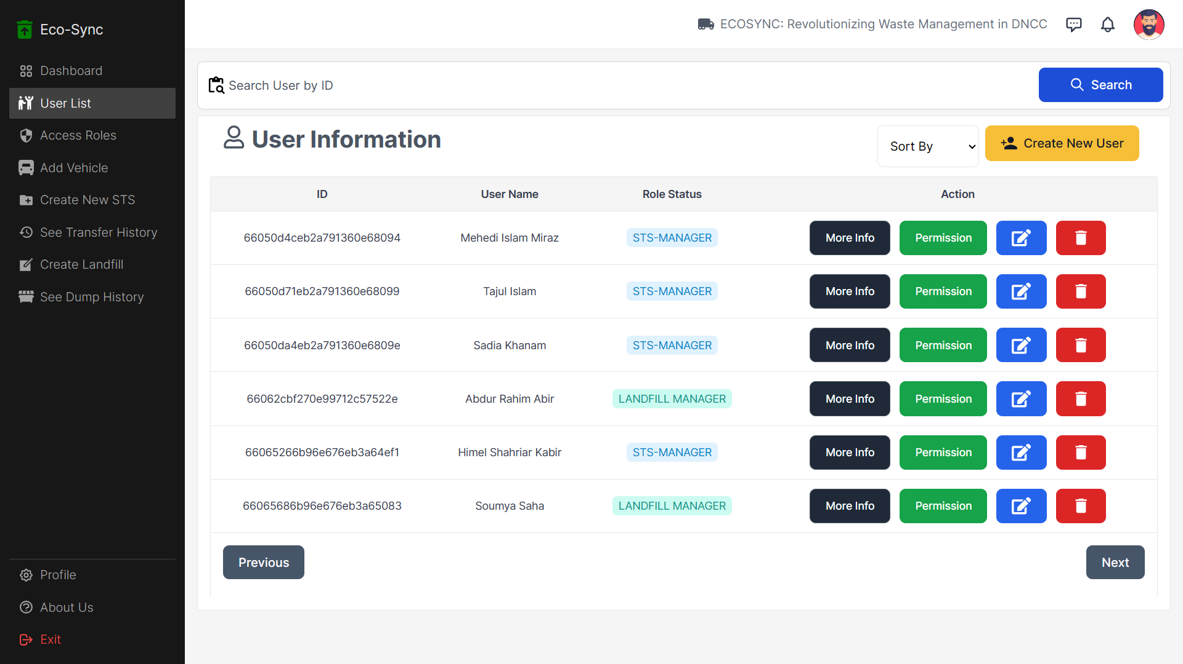
User List Page ( Only Admin Can See)

Slide 10
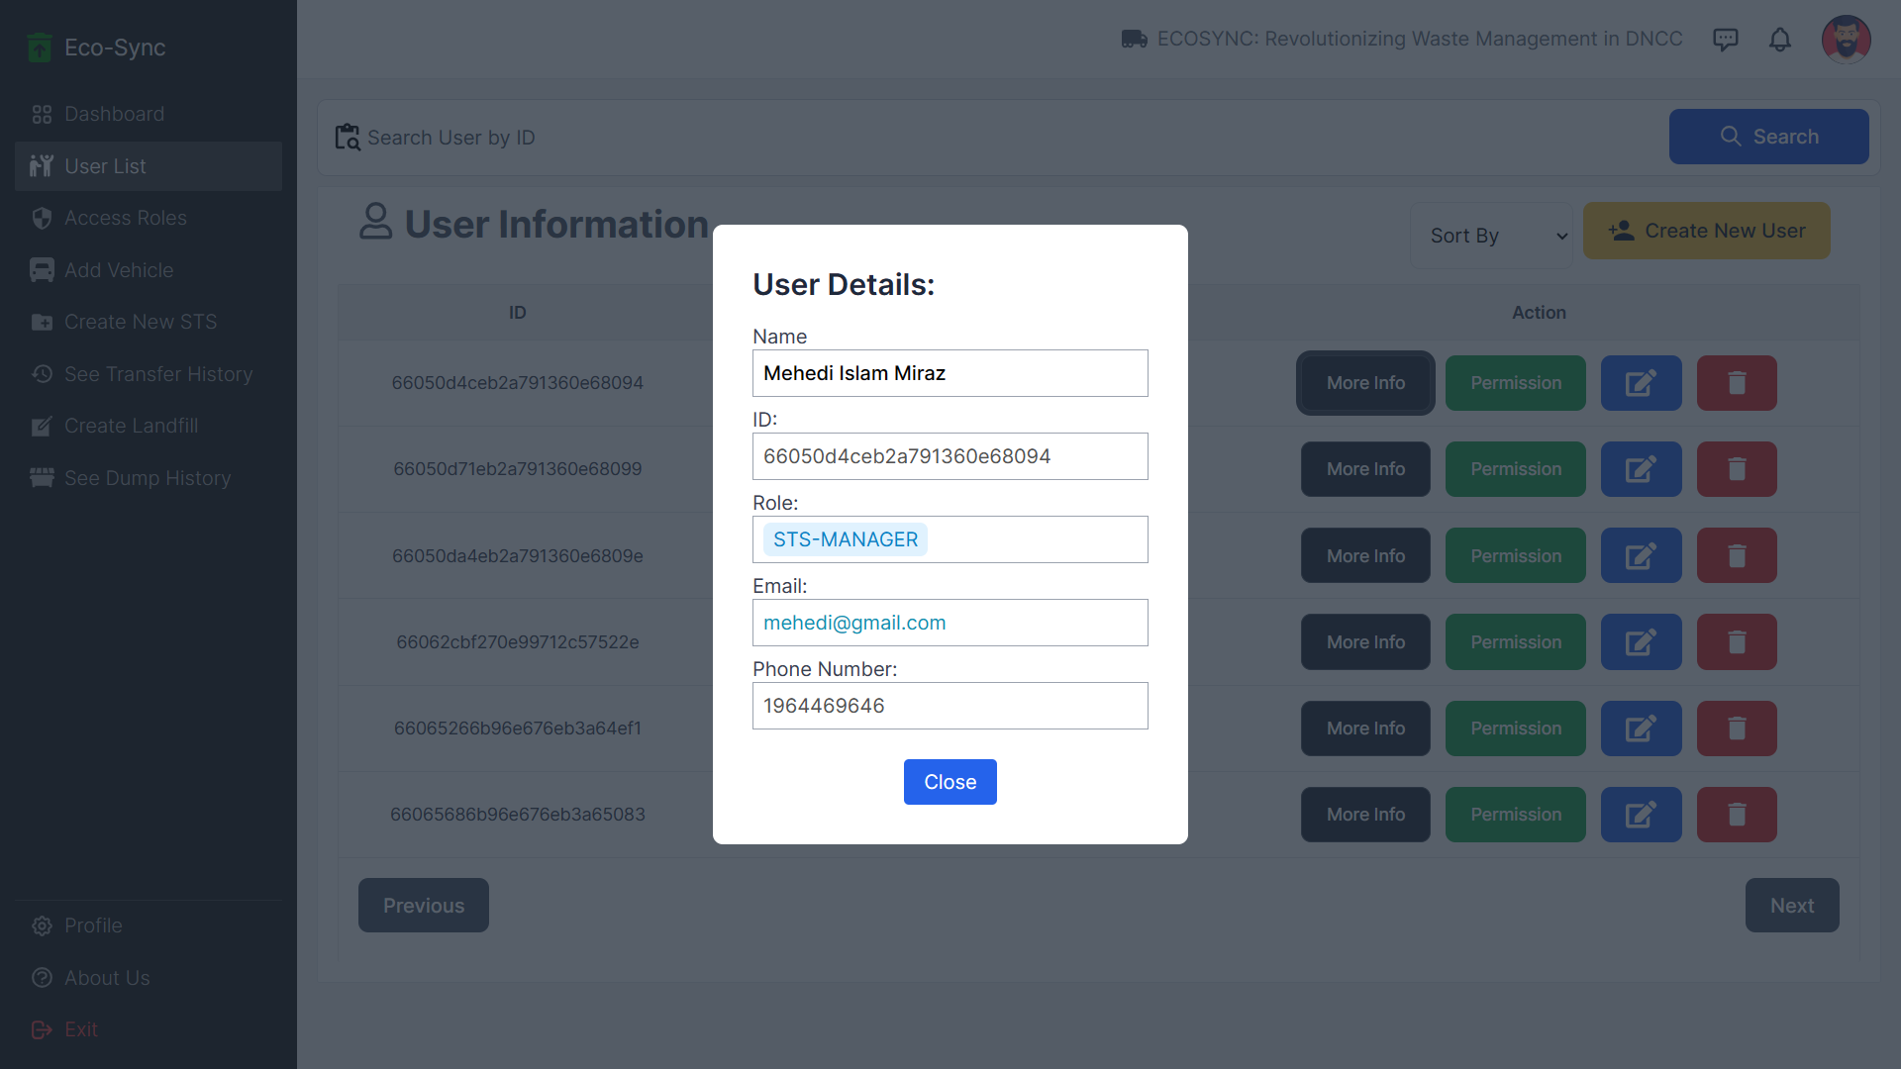
Clicked More Info Button : Showing All Information of a USER

Slide 11
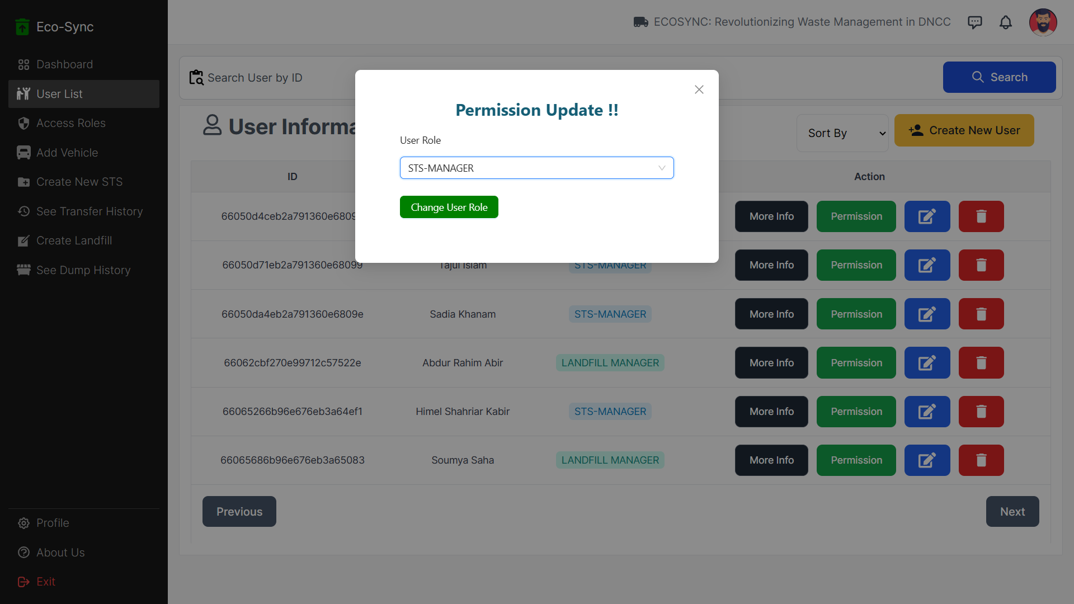
Clicked Permission Button : Admin can change user role dynamically

Slide 12
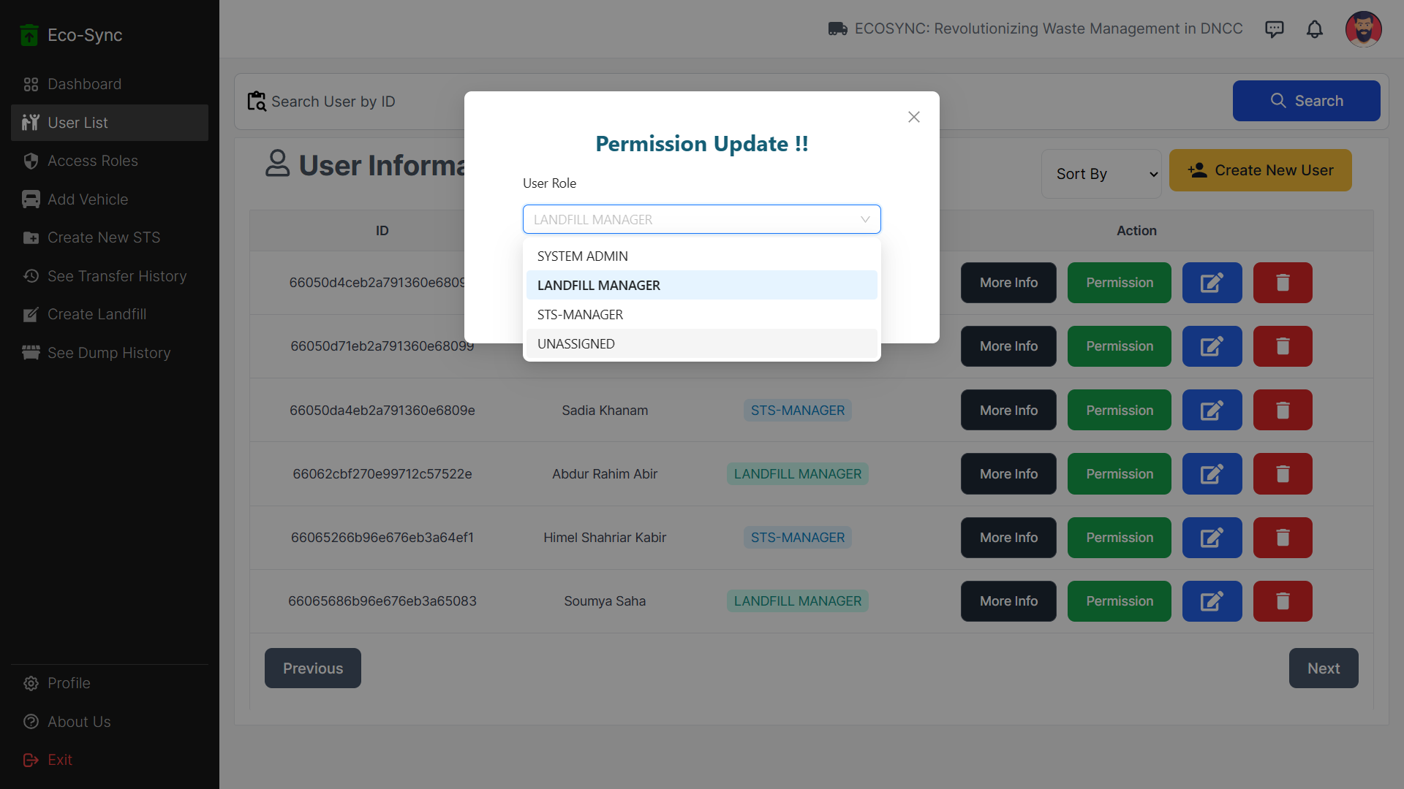
List of Available Roles to change Role

Slide 13
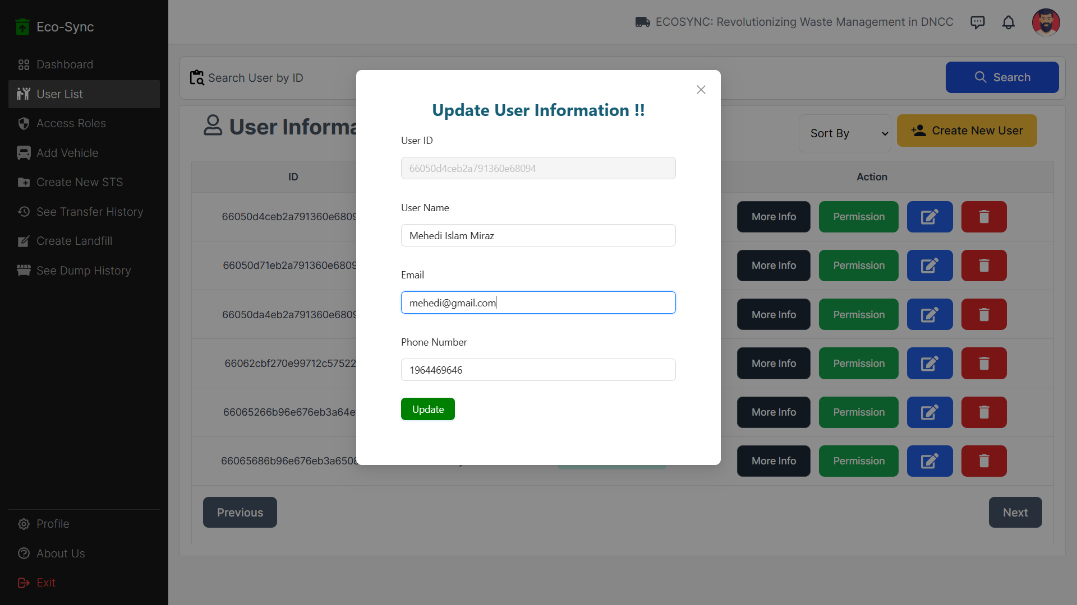
Clicked Edit Button : Can Edit User Information

Slide 14
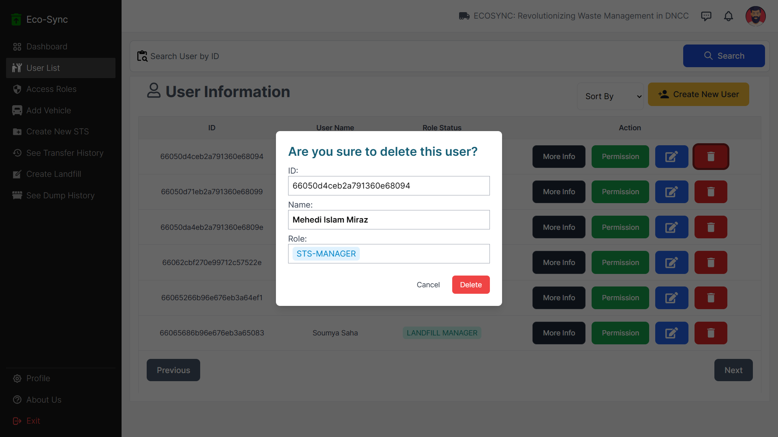
Clicked Delete Button : Can Delete a User

Slide 15
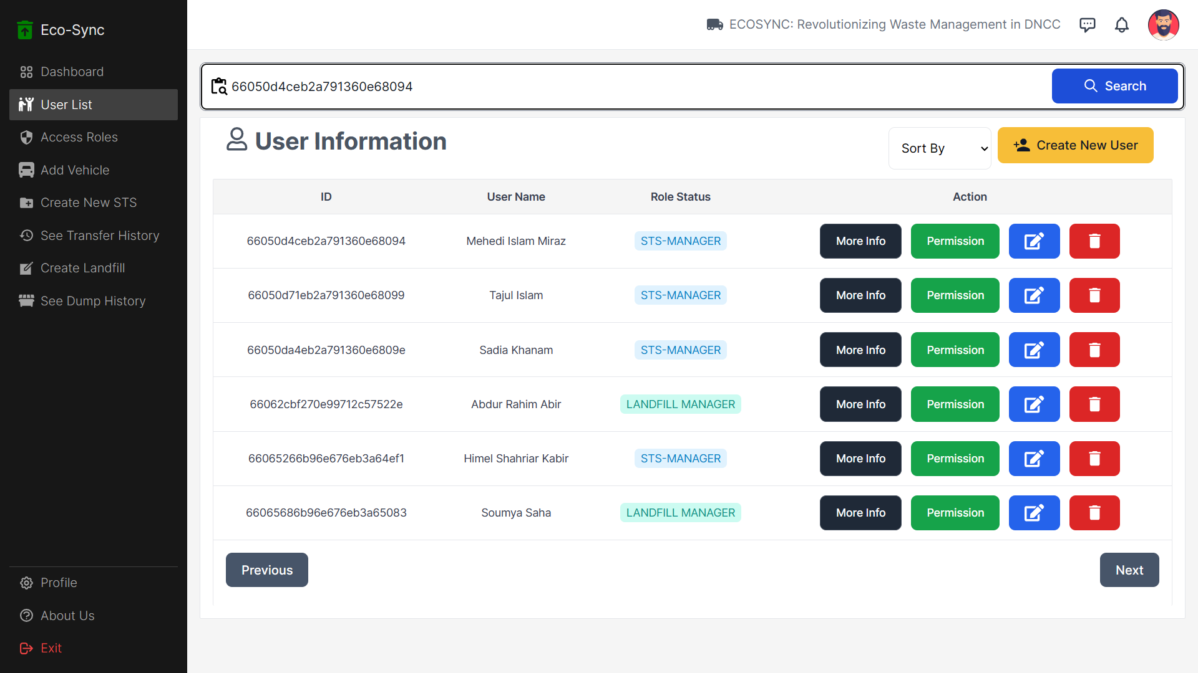
Searching User Based on ID

Slide 16
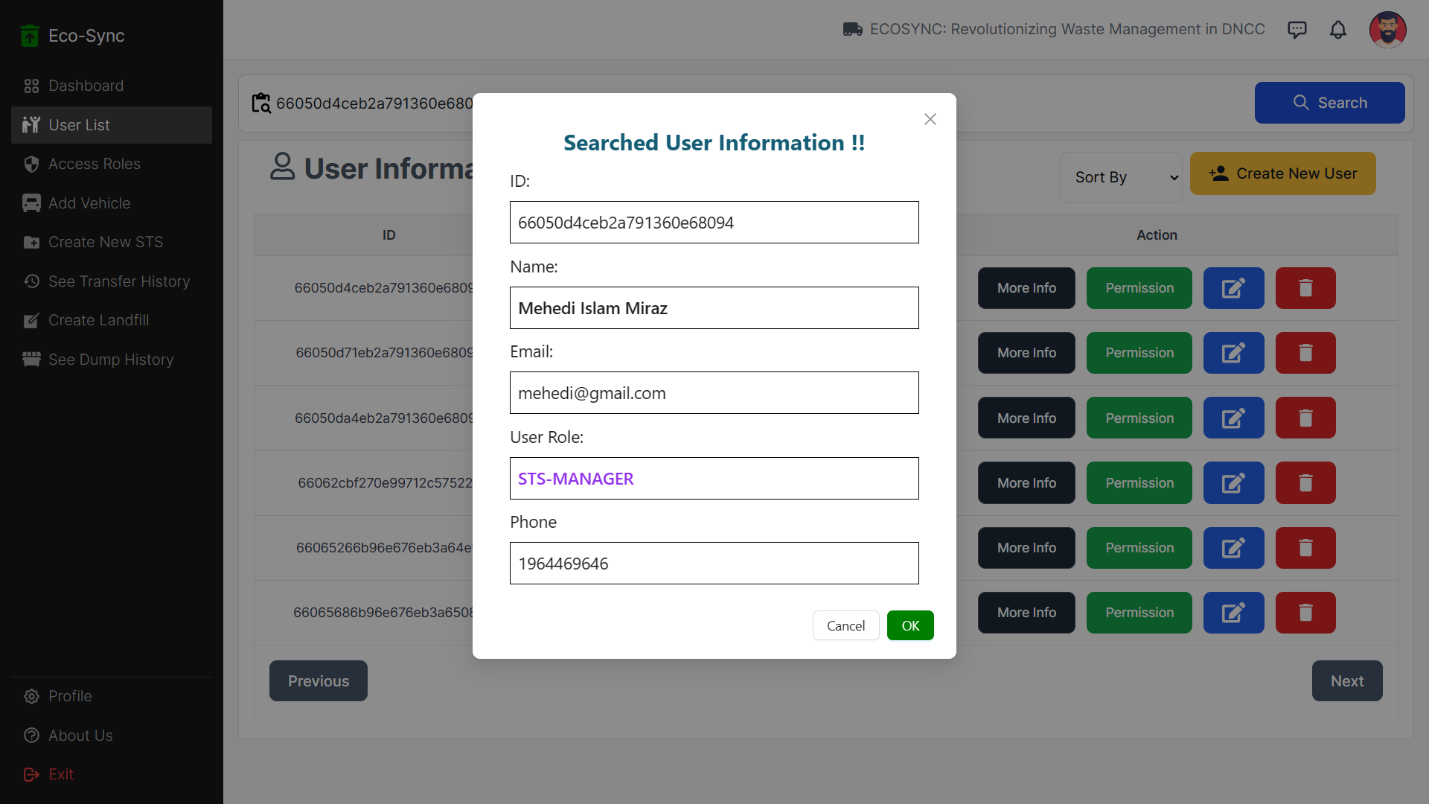
Searched User Found !

Slide 17
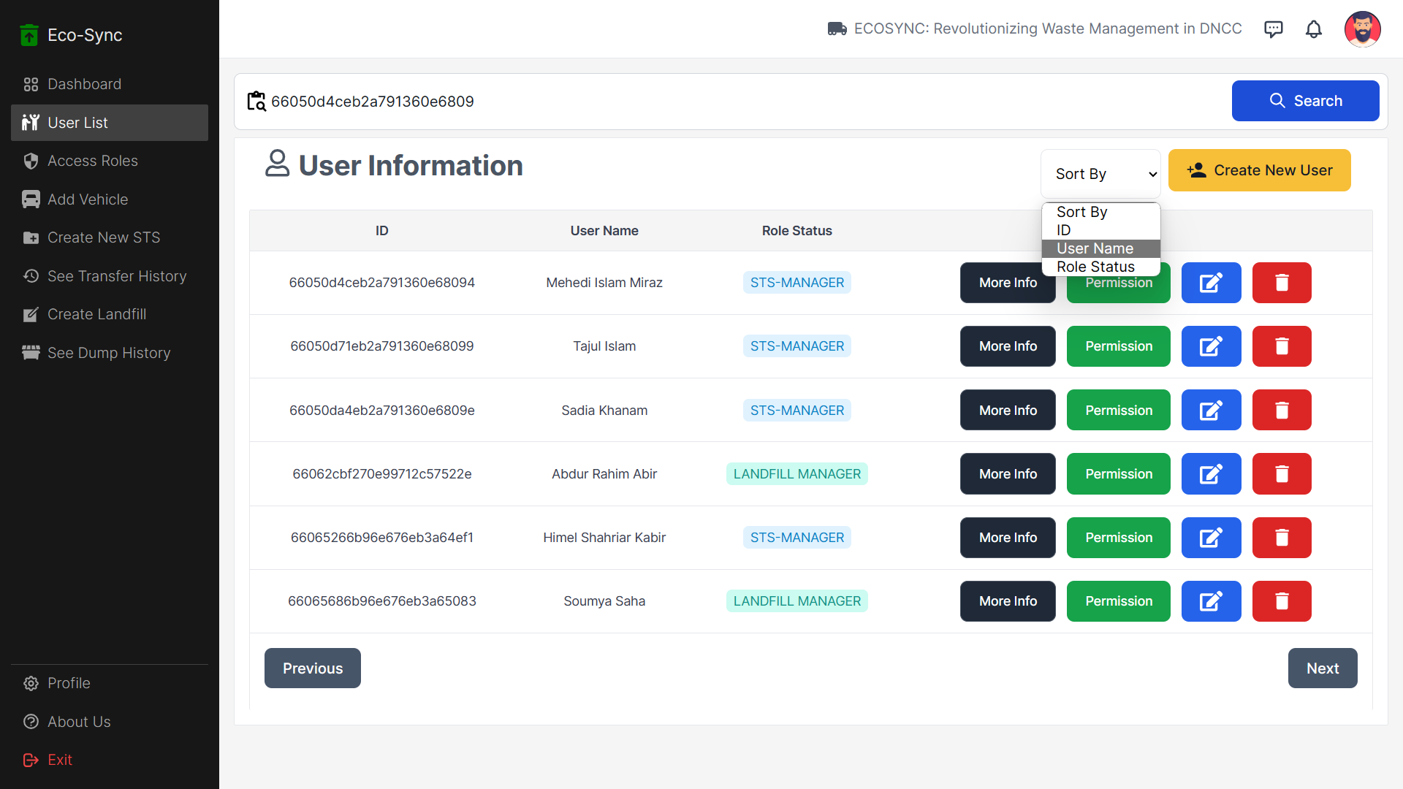
Sorting USER List Based on Username

Slide 18
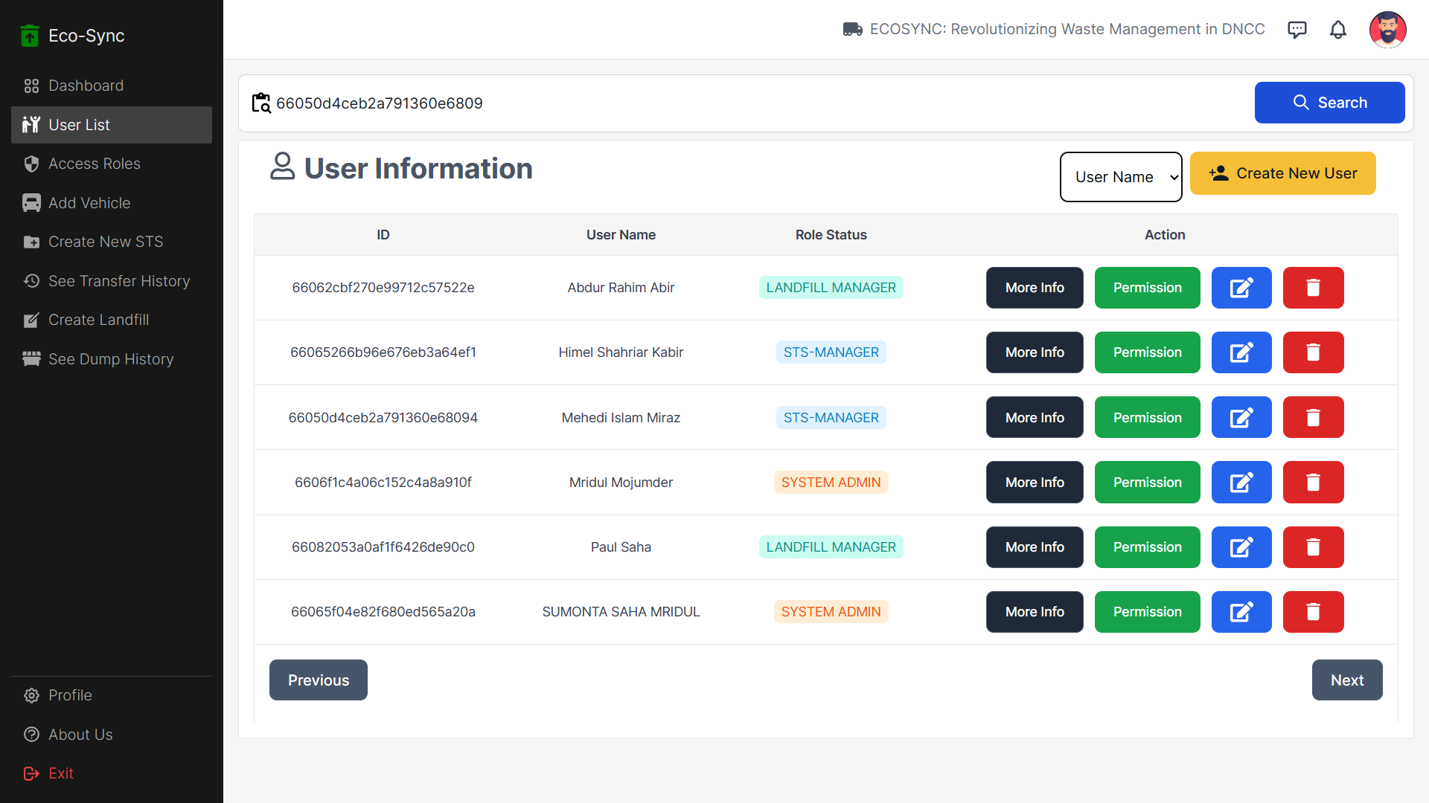
User List Sorted Based On Username

Slide 19
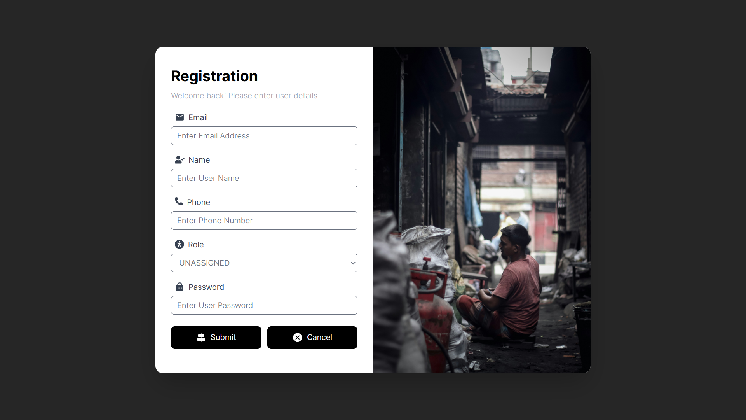
Registration: To Create New User Page For Admin

Slide 20
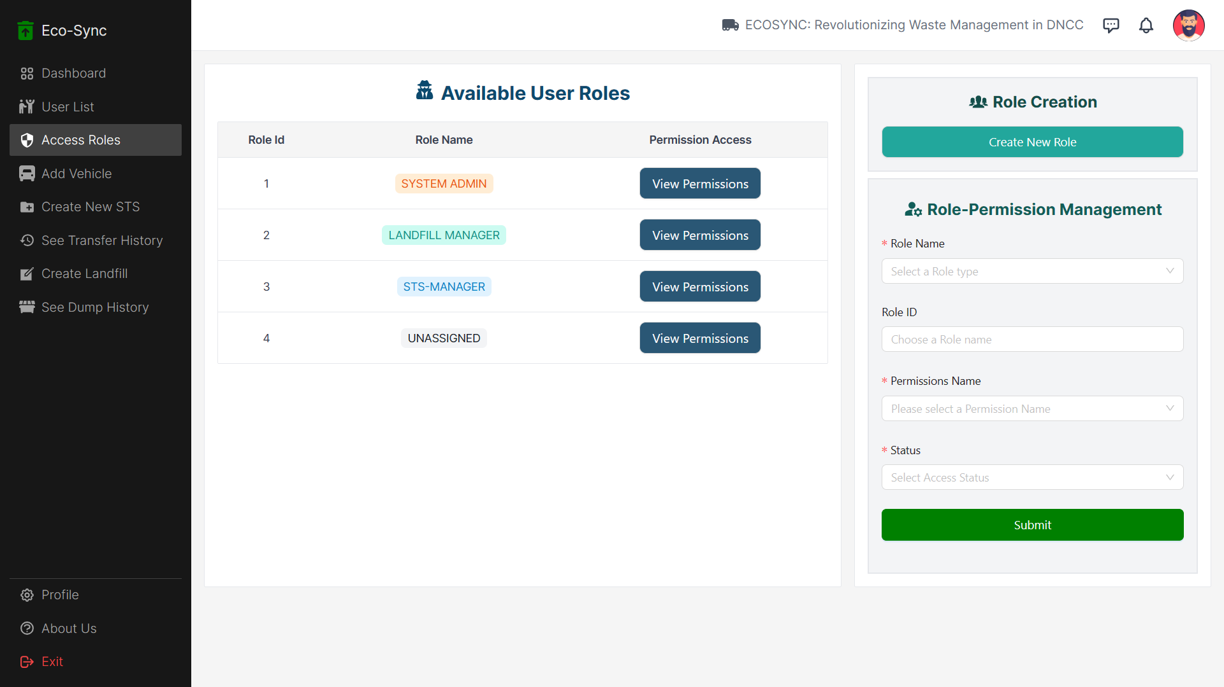
Role and Permission Page For Admin

Slide 21
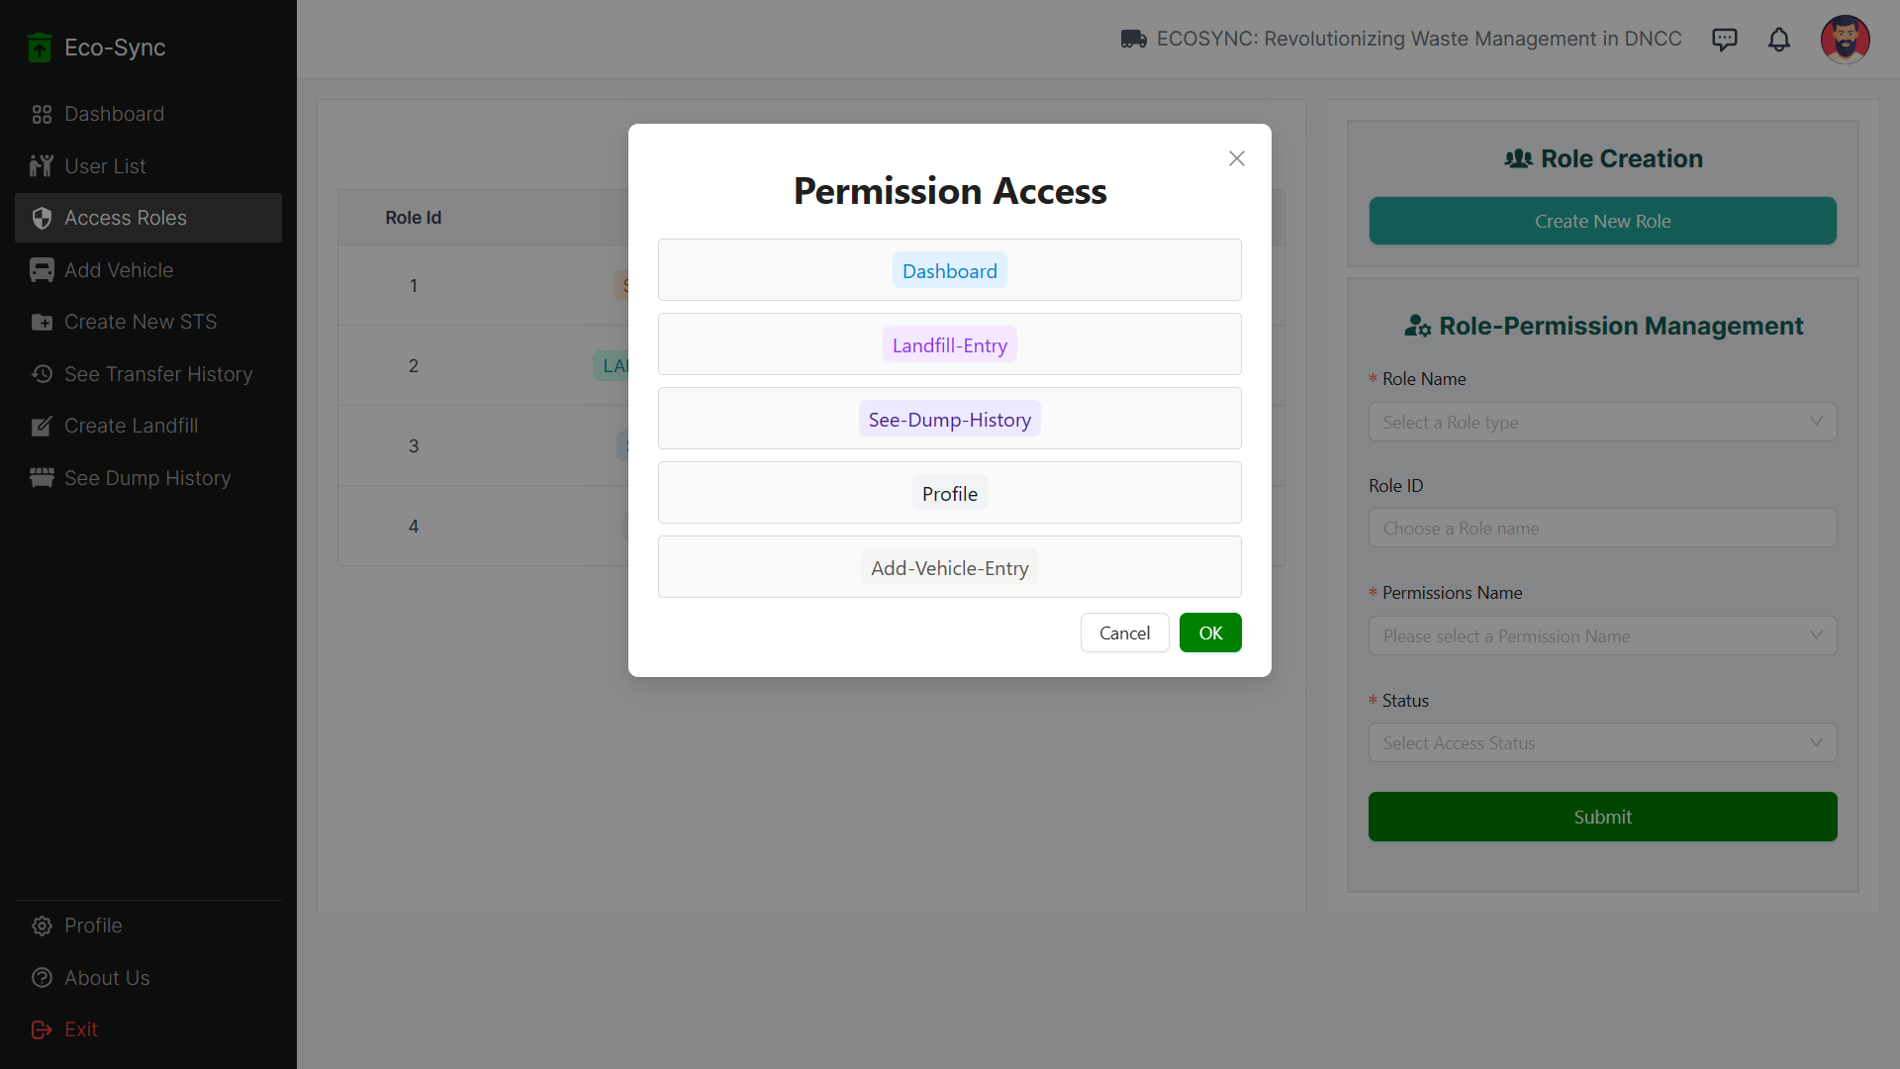
Clicked View Permission Button : Showing permission of Role (“Landfill Manager”)

Slide 22
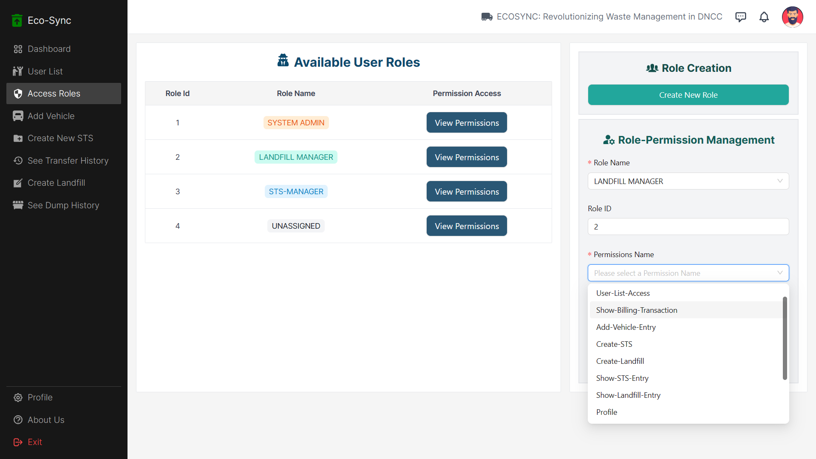
In Role-Permission Form : Can give Access / Deny Access to a Role

Slide 23
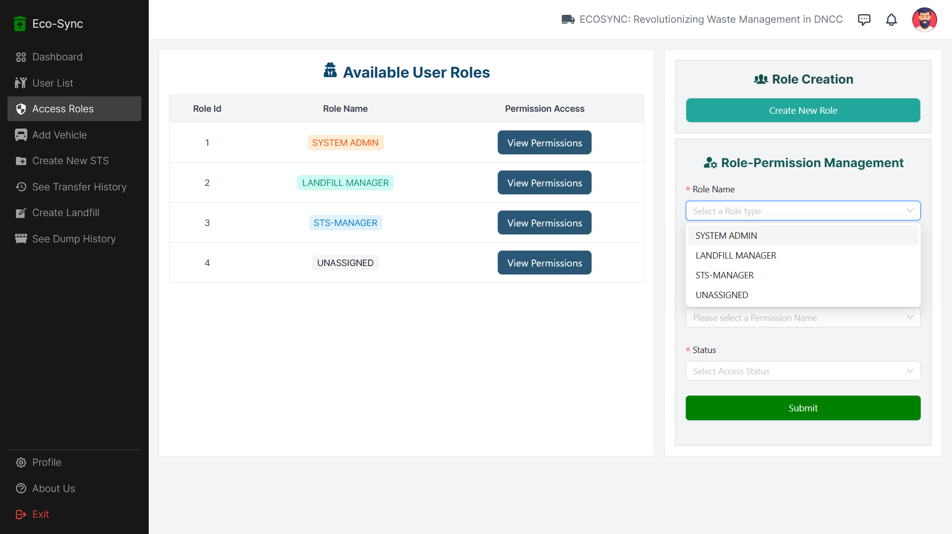
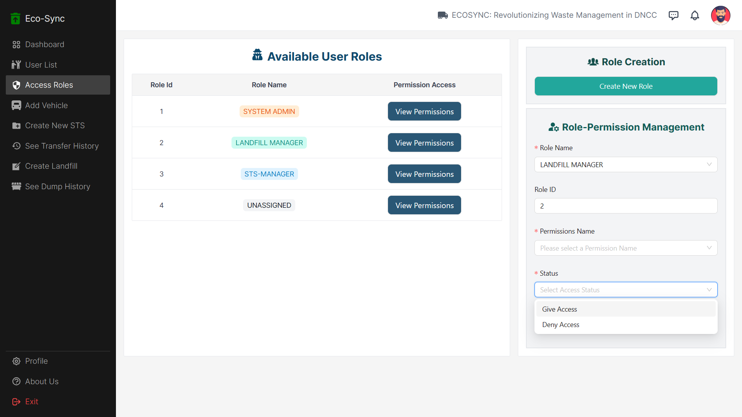
Step - 1 : Choosing Role
Step - 2 : Choose Permission
Step - 3 : Give/Deny Access

Slide 24
Admin can create any role and permission for that role and give/deny access to permission for any user.
(All forms on the website include options chosen based on backend data)

Slide 25
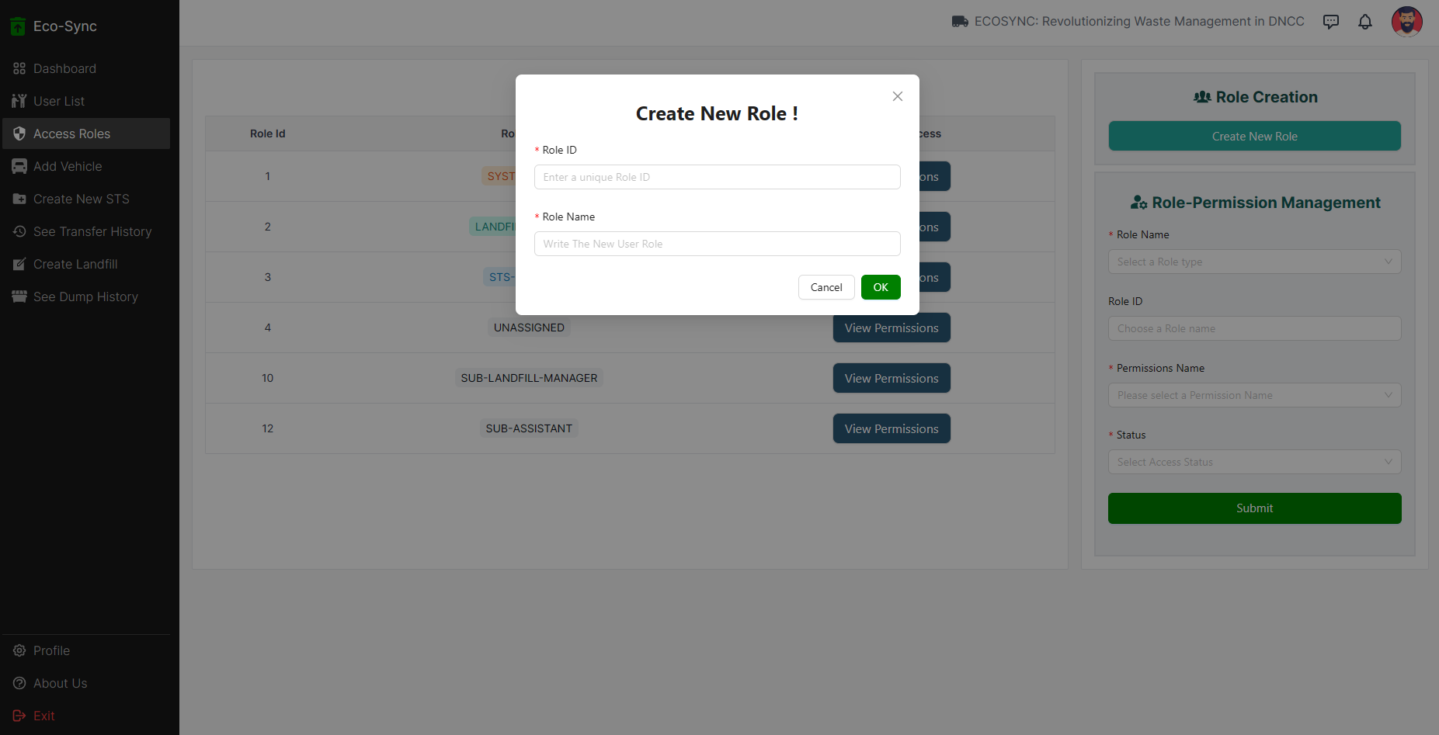
Create a New Role Page

Slide 26
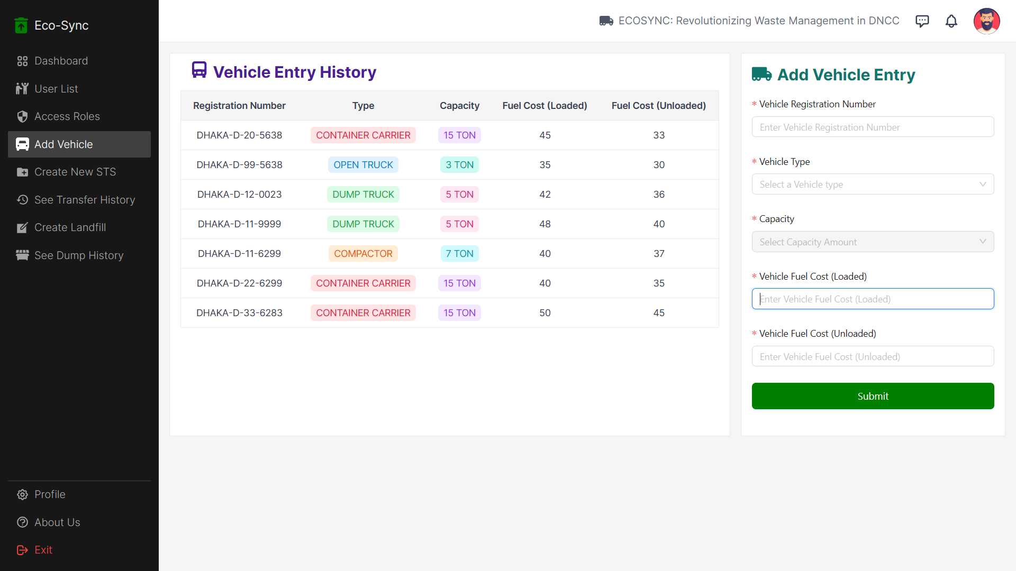
Admin Can Add New Vehicle Entry Form + Can View Vehicle Entry History Page

Slide 27
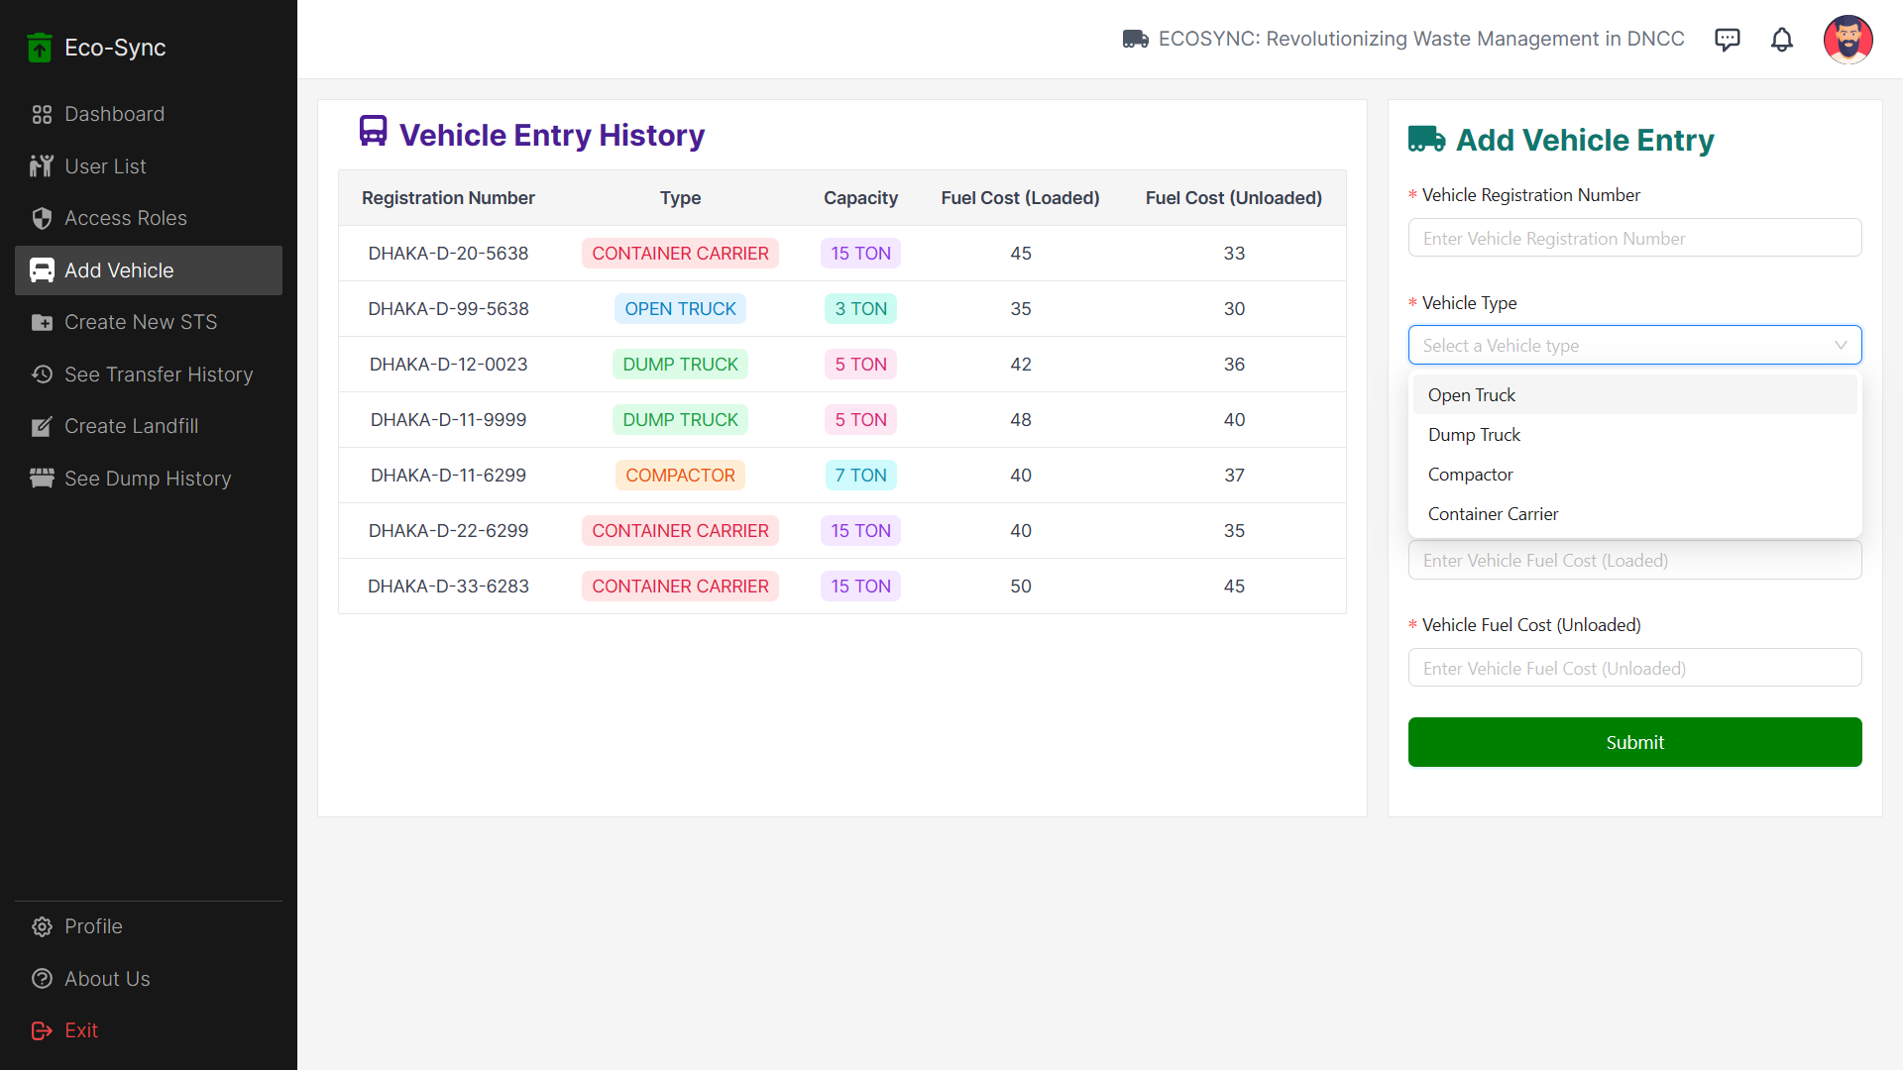
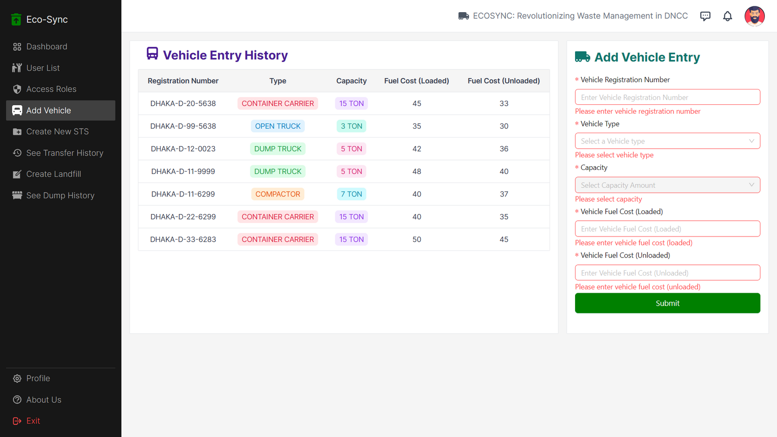
A view of the vehicle Entry Form Choosing Vehicle Type
Validation Check

Slide 28
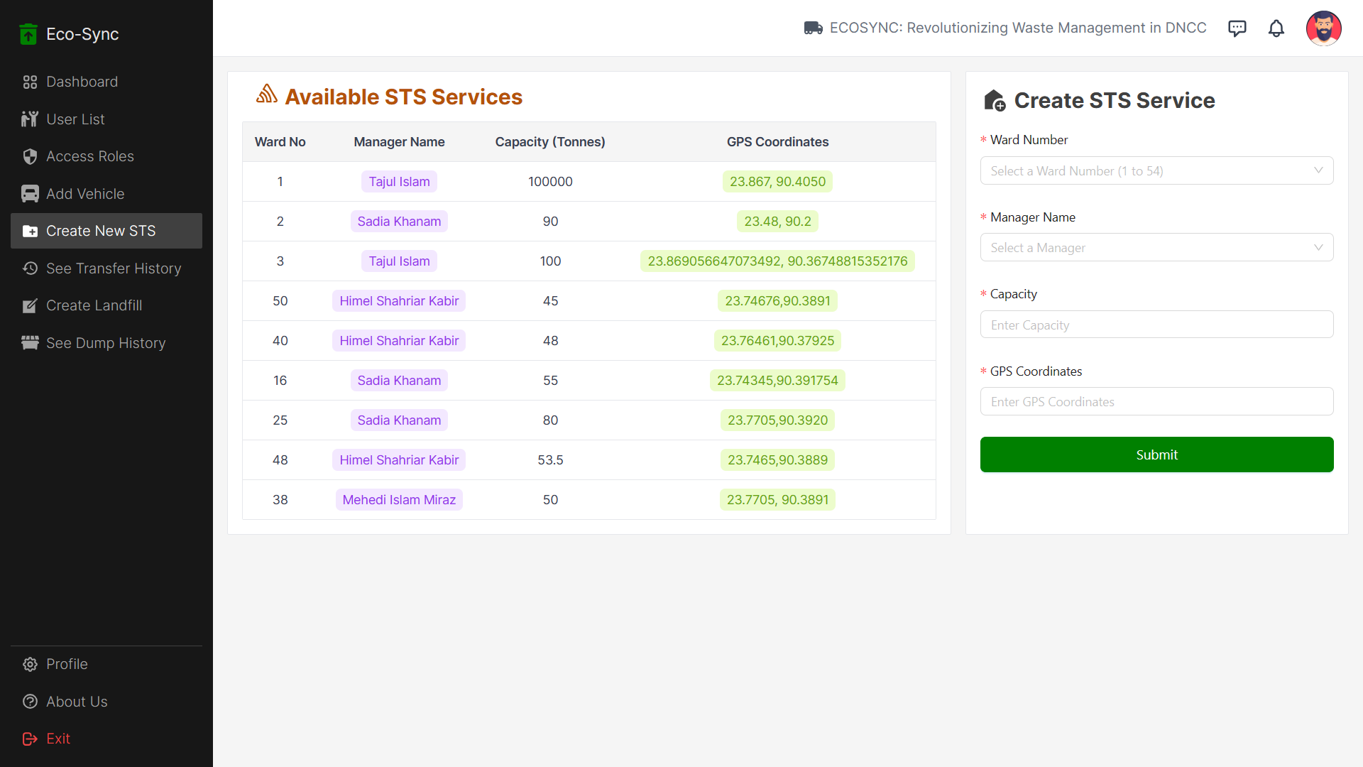
Admin Can Create New STS Form + Can See Available STS

Slide 29
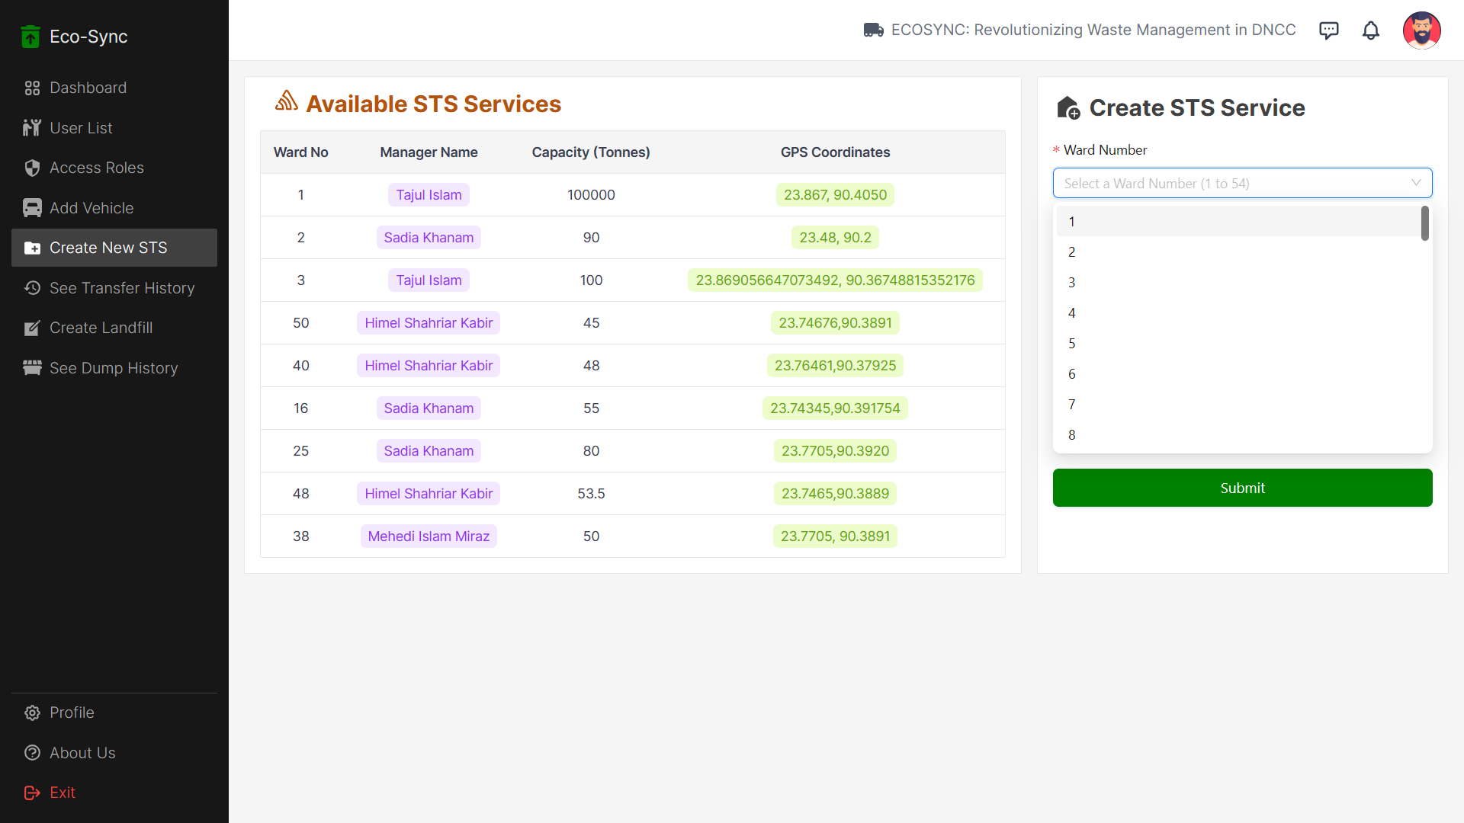
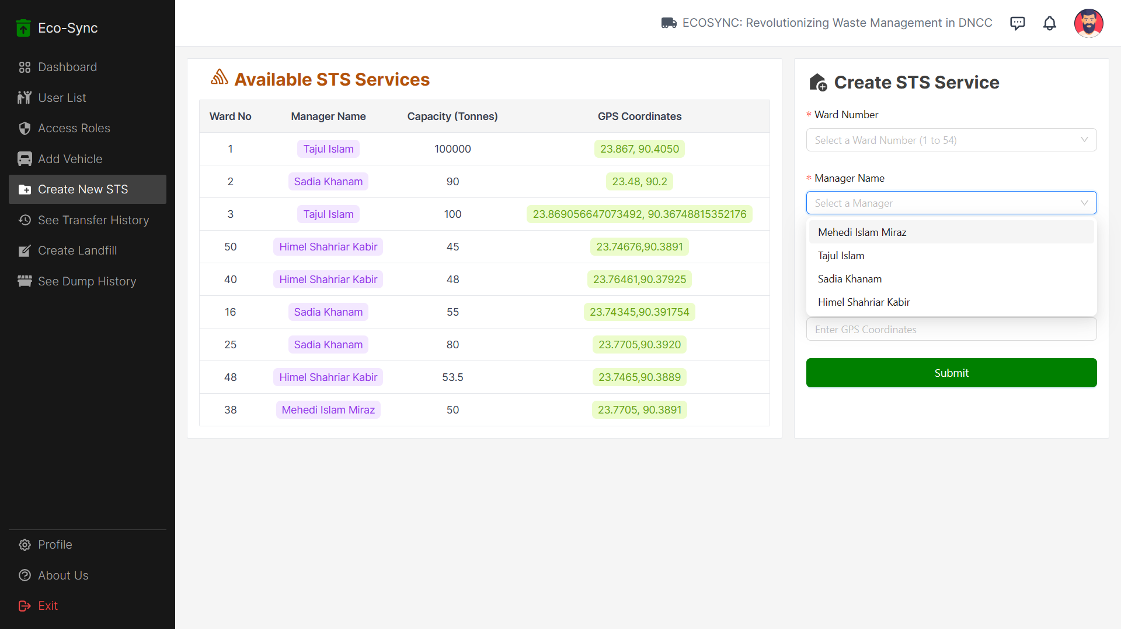
Choose Ward No
(1 to 54)
Fill Up other Information
Choose Available STS
Manager

Slide 30
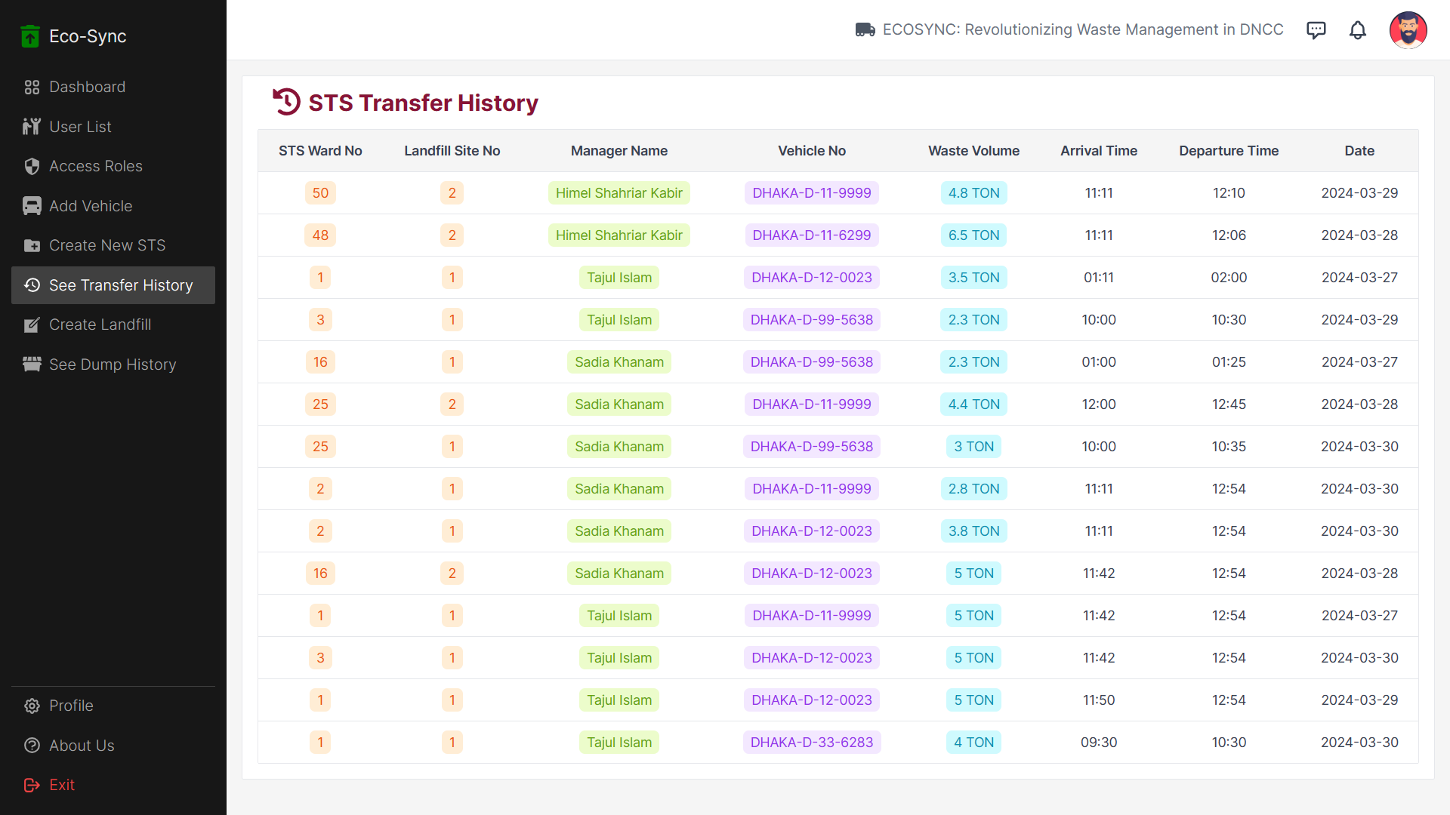
Admin Can See STS Transfer History Page

Slide 31
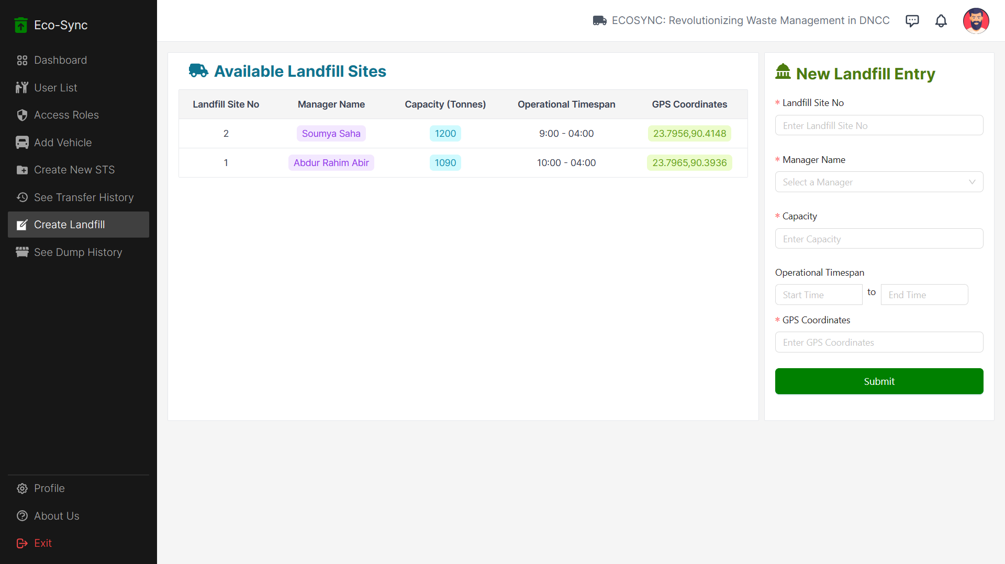
Create New Landfill and History of Created Landfills

Slide 32
USER ROLE : STS MANGER
Perspective from an STS Manager

Slide 33

Logging in as an STS Manager

Slide 34
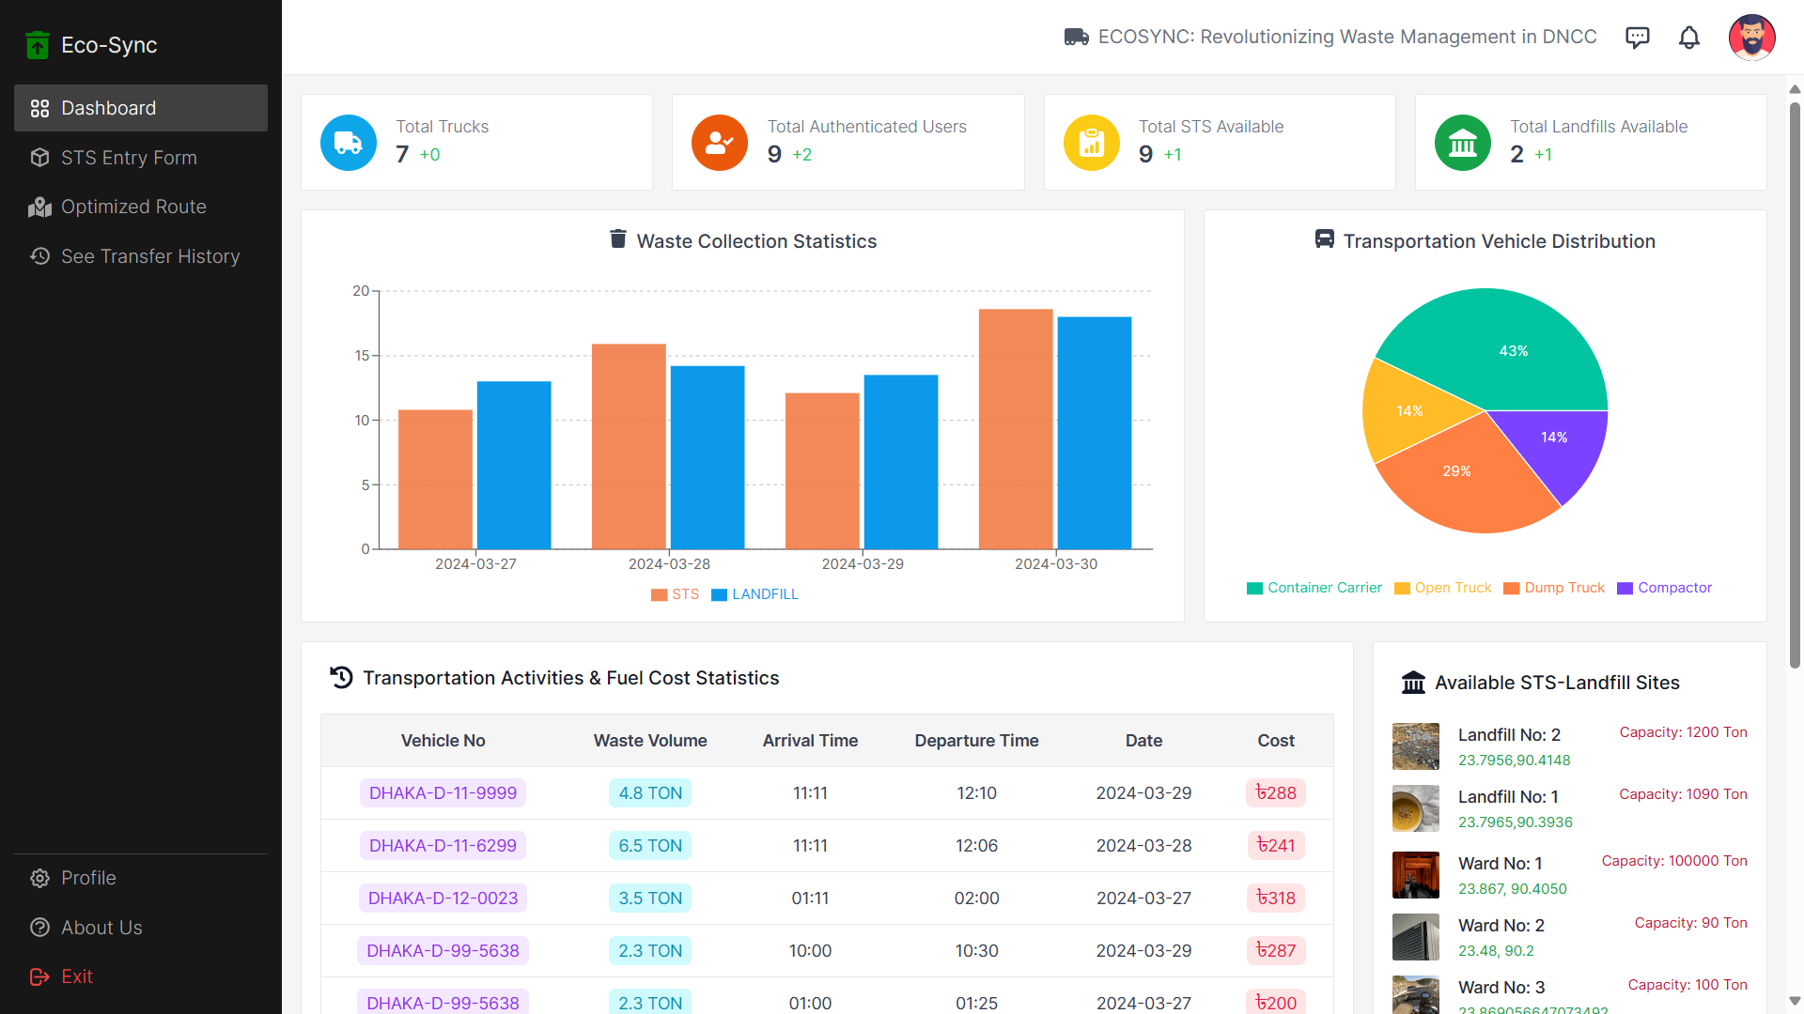
STS Manager Has a Different Side Navbar than Admin ( Cannot Access Those Page)

Slide 35
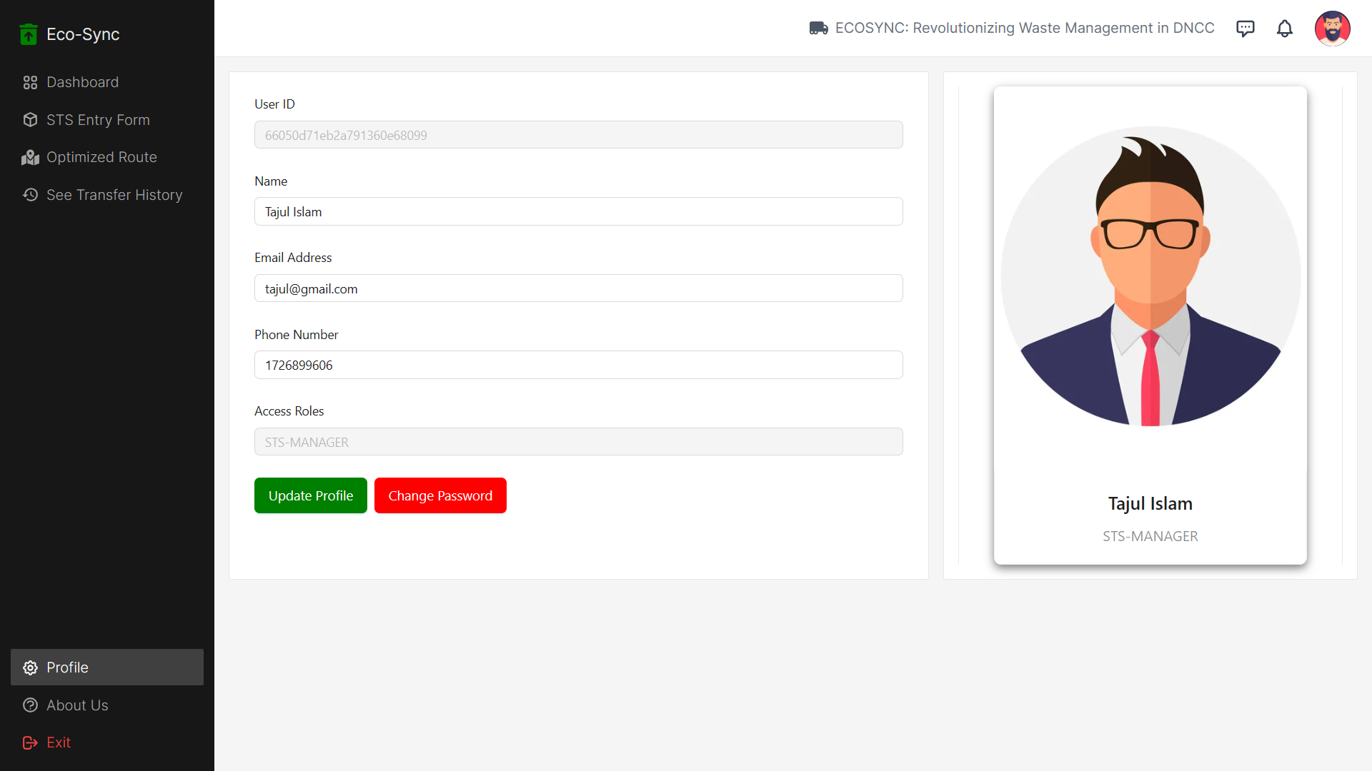
STS Profile Page

Slide 36
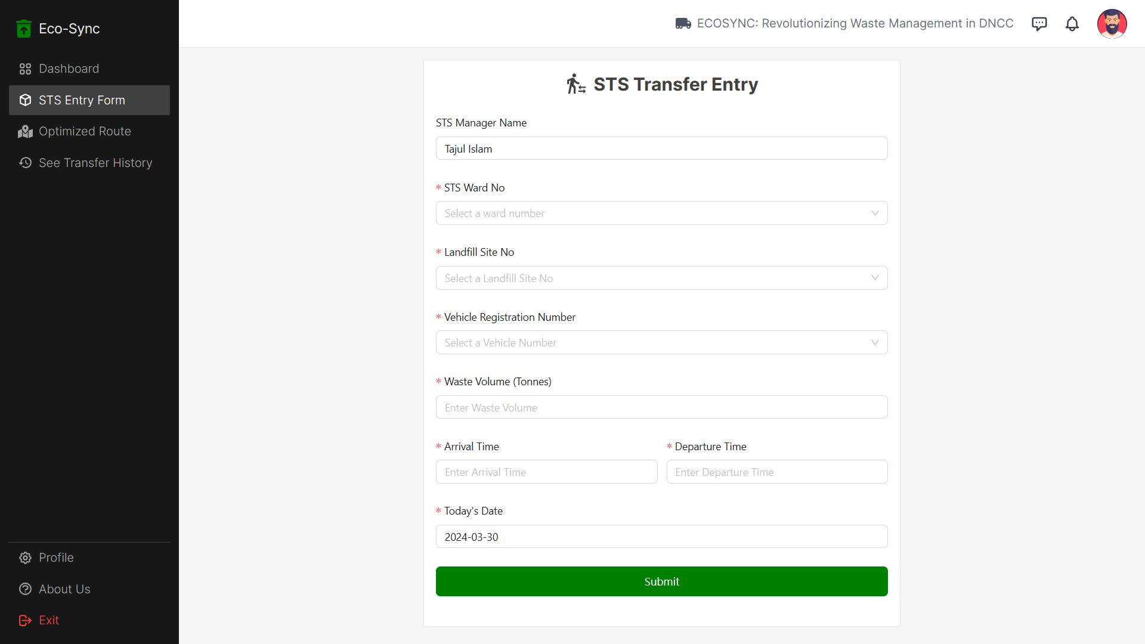
STS Manager can access to STS Transfer Data Entry Form

Slide 37
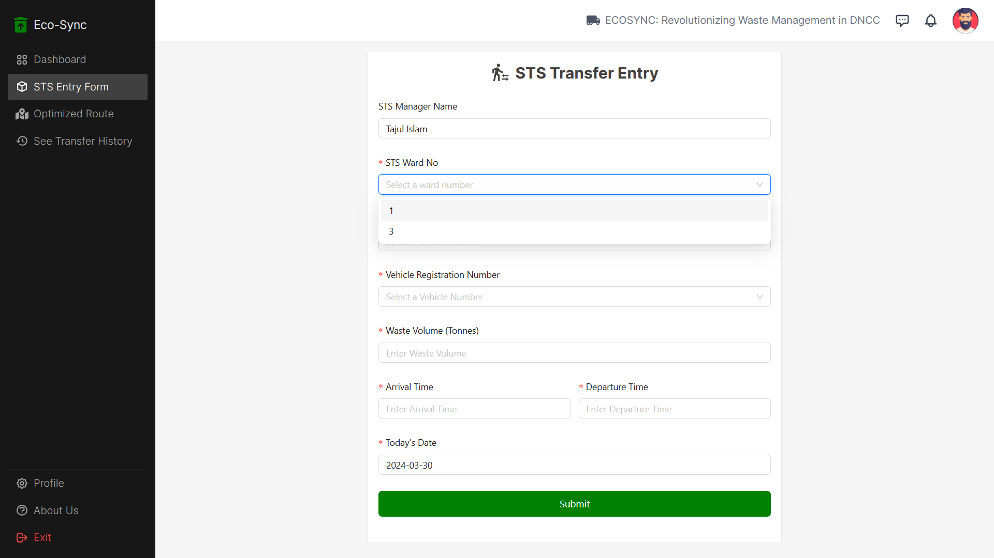
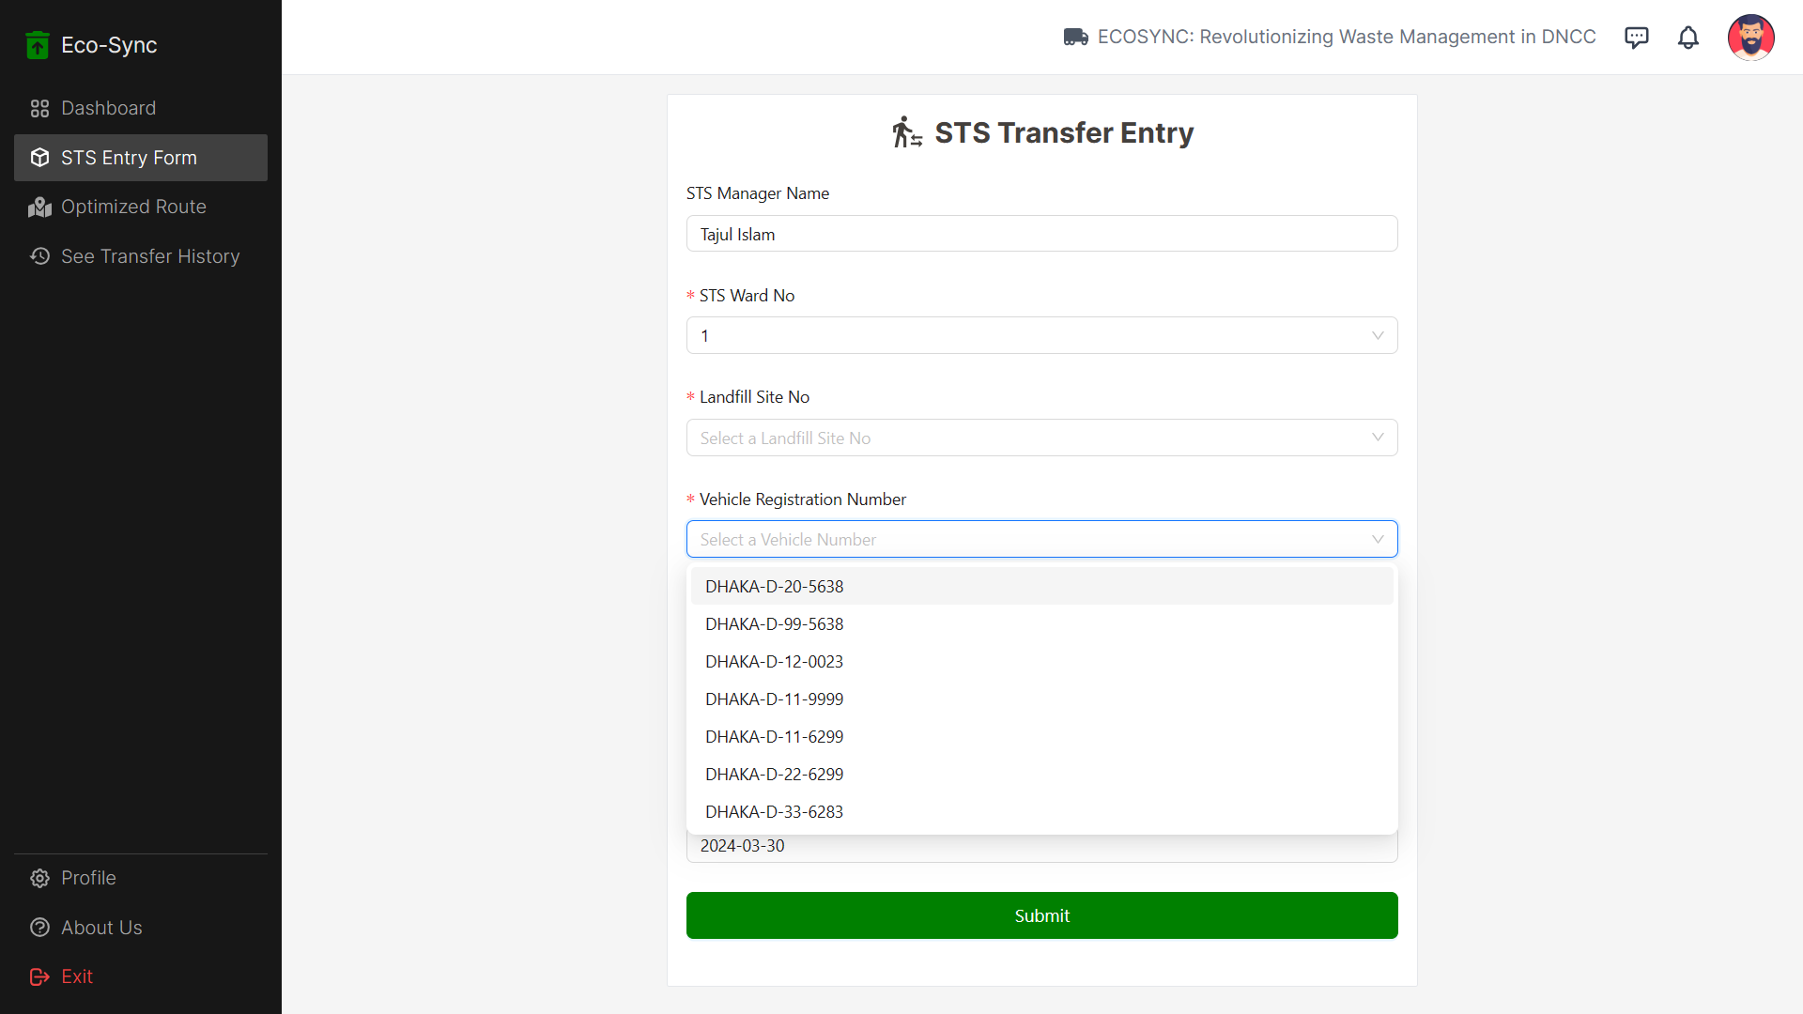
The STS manager can only choose the STS that he has access to
Choosing available Vehicle

Slide 38
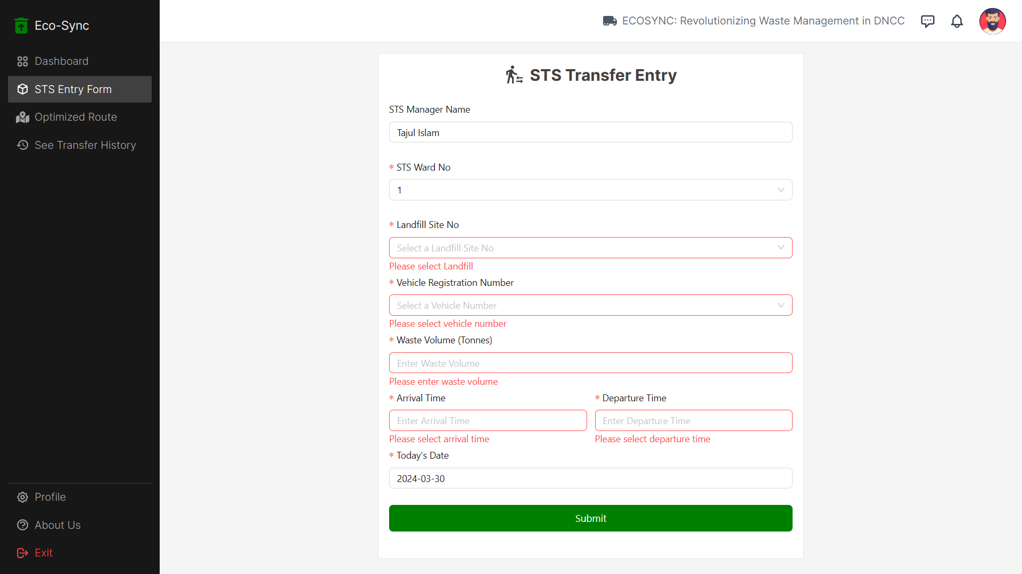
All Forms in this Website includes Validation

Slide 39
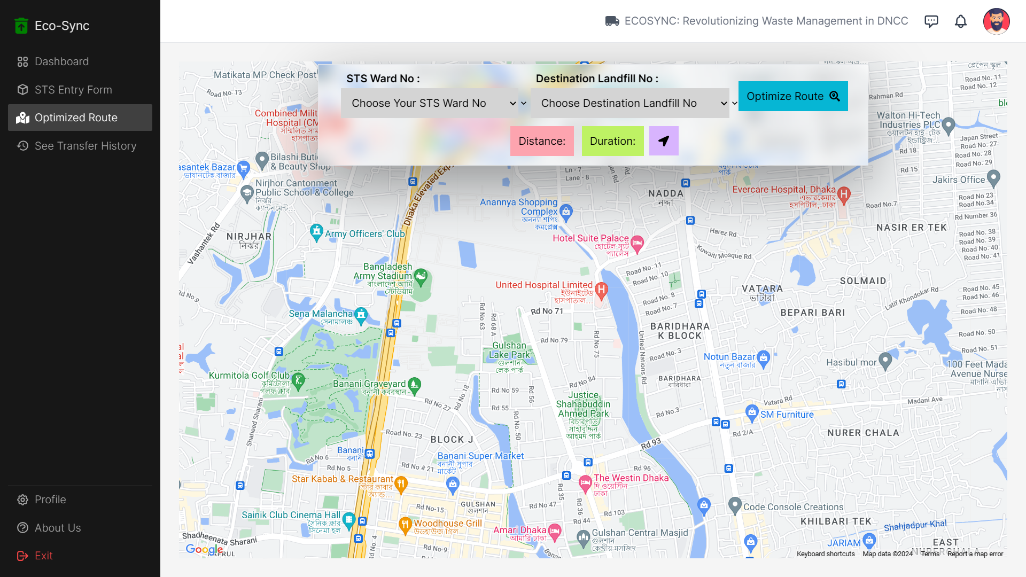
Route Optimiztation View Page For STS Manager

Slide 40
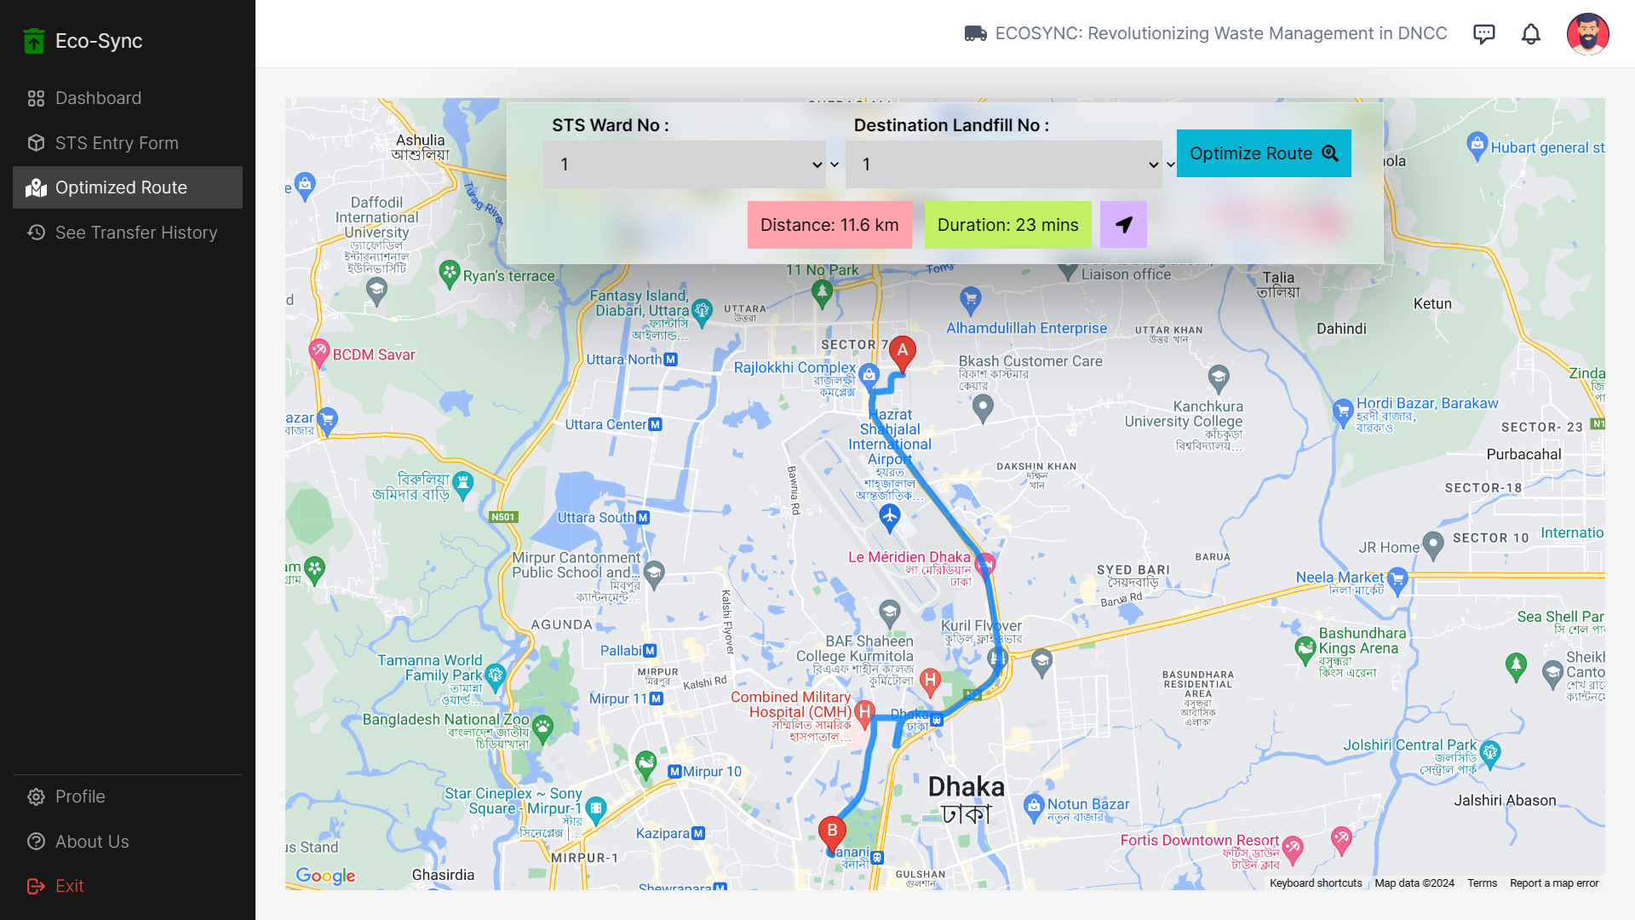
Showing Optimized Route For STS no 1 to Landfill No 1

Slide 41
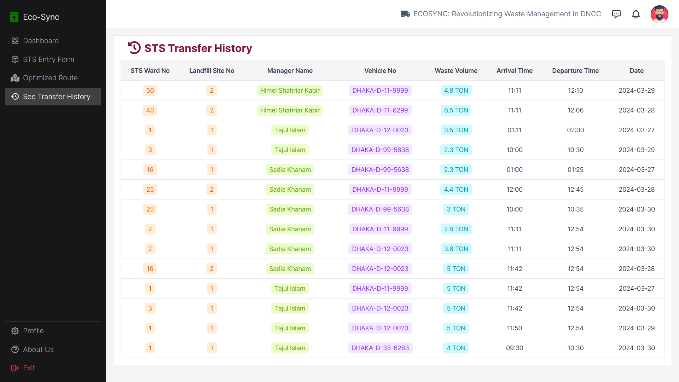
STS Manager can view STS Transfer History

Slide 42
USER ROLE : LANDFILL MANAGER
Perspective from a Landfill Manager

Slide 43
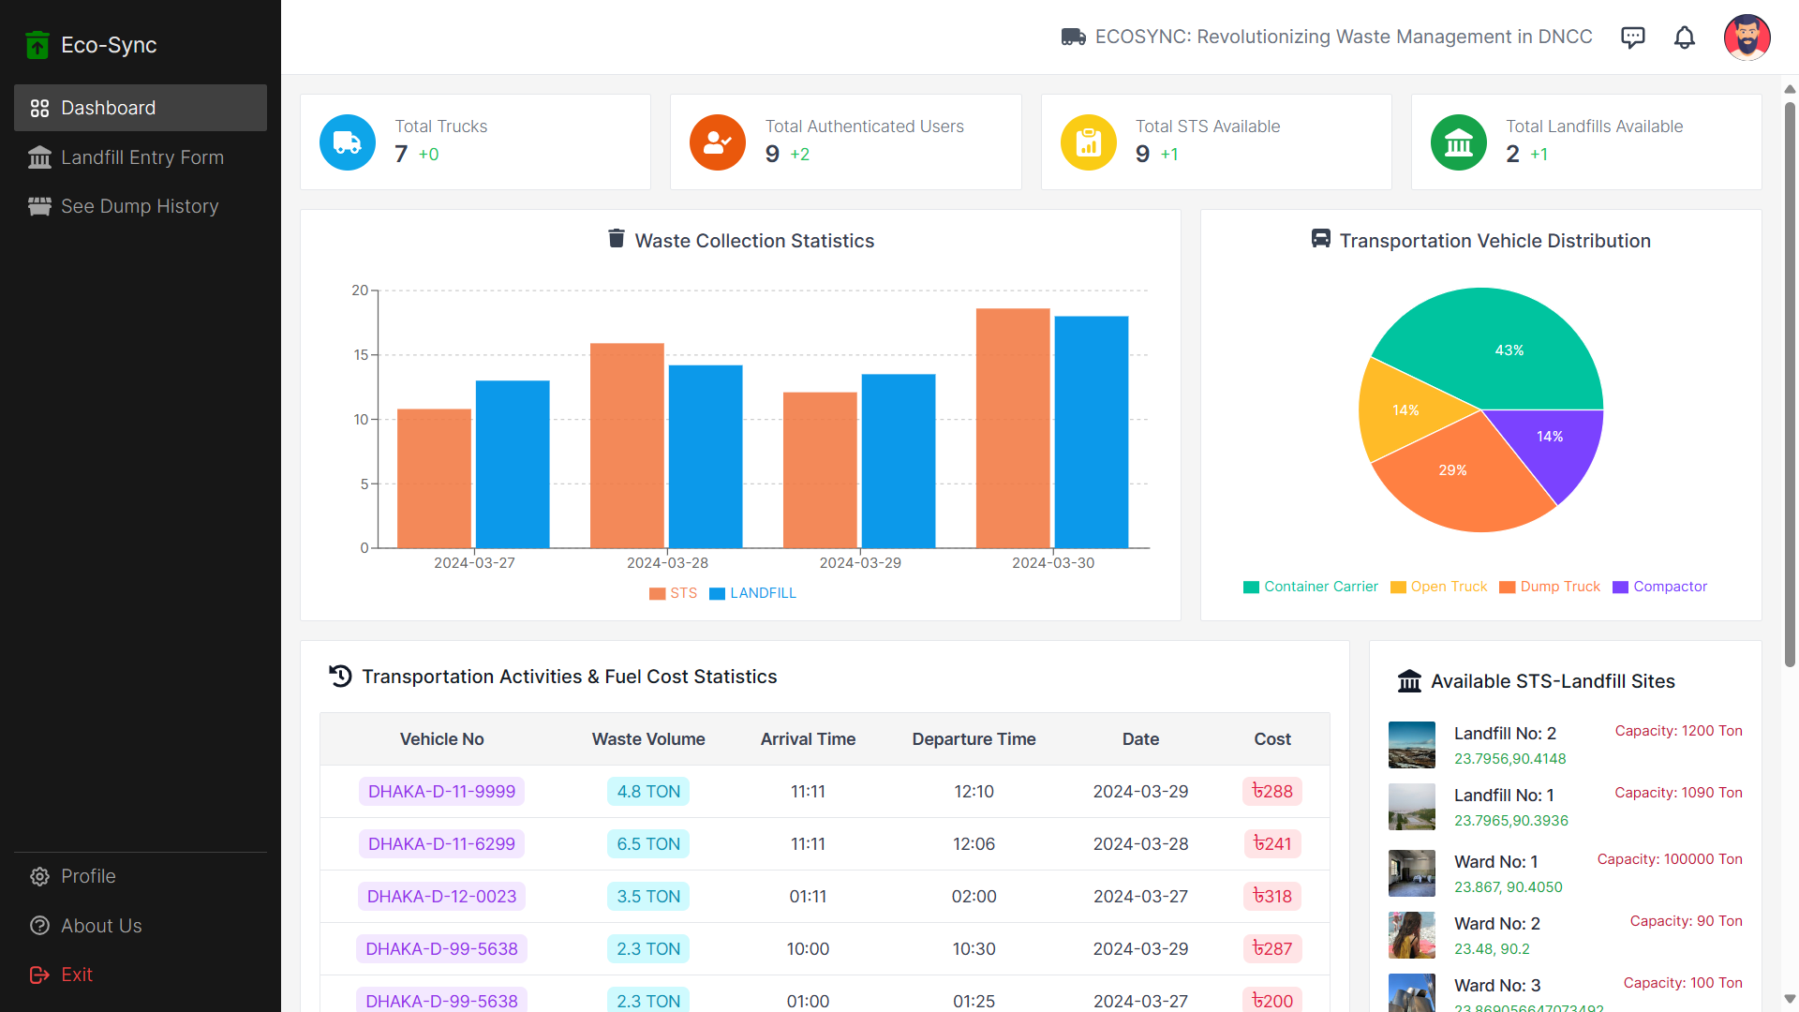
Different Side Navbar from both STS Manager and Admin

Slide 44

Landfill Manager Profile

Slide 45
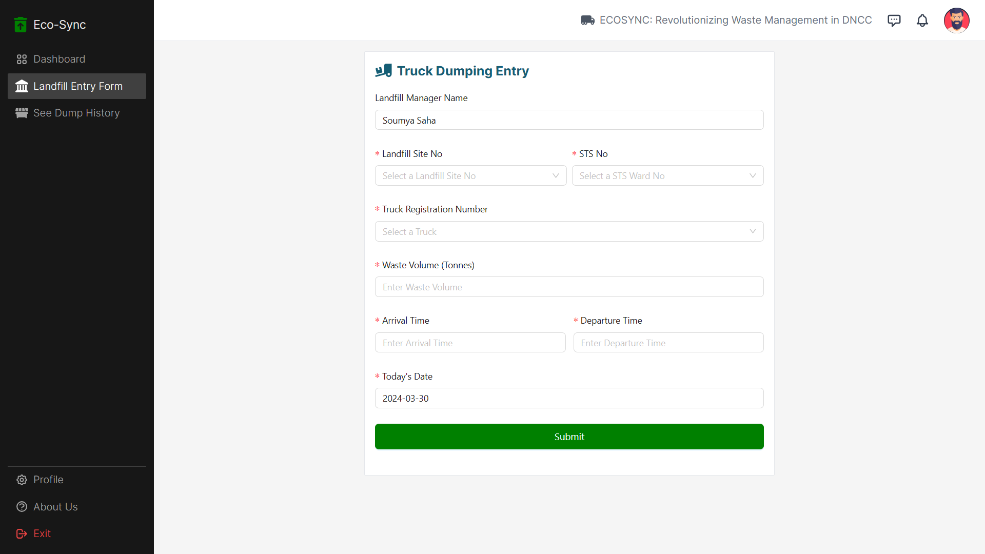
Landfill Manager can add Truck Dumping Entry

Slide 46
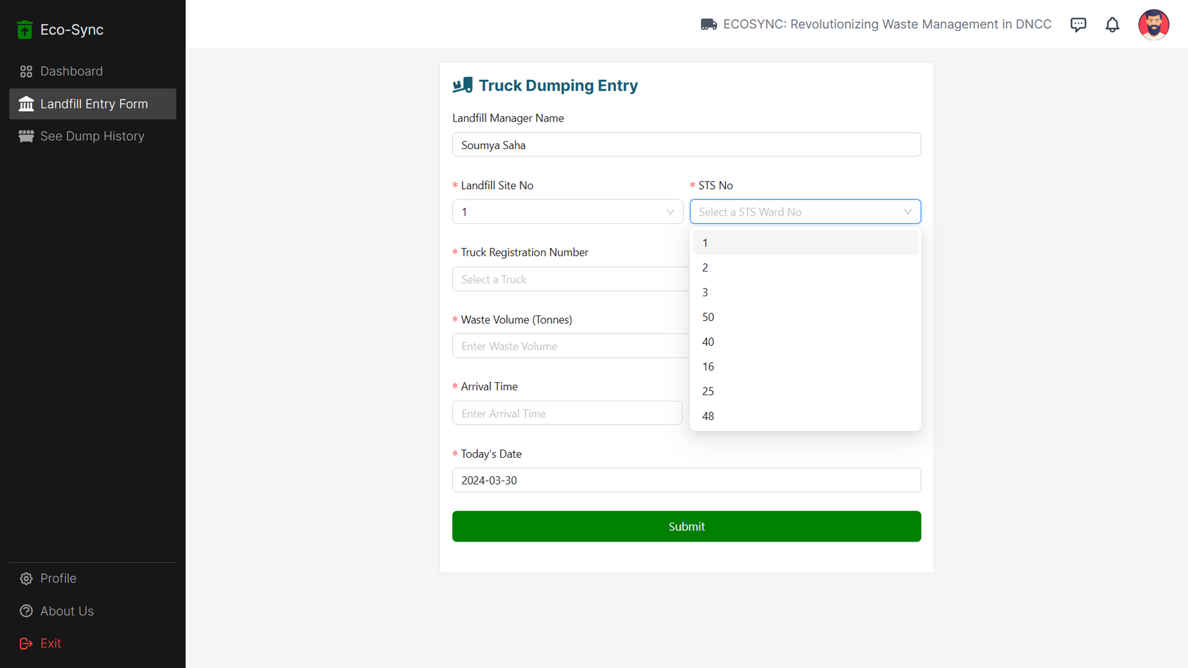
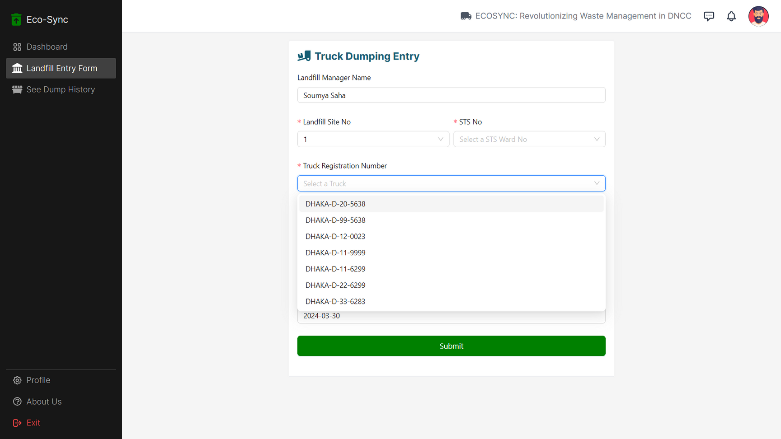
All forms include options chosen based on backend data rather than manual typing, ensuring the maintenance of data consistency and connectivity

Slide 47
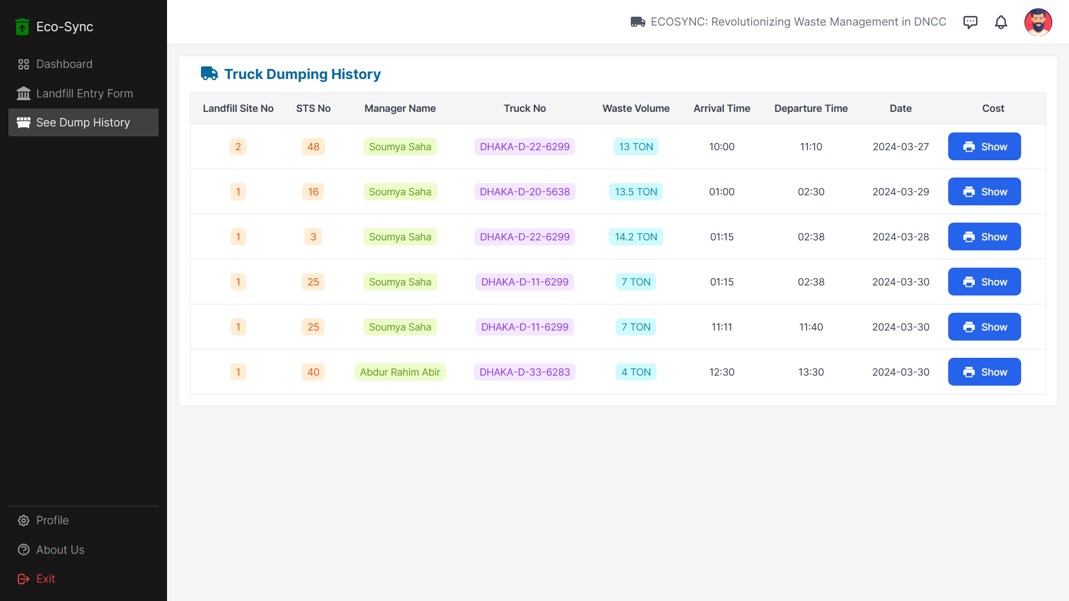
Truck Dumping History For Landfill Manager

Slide 48
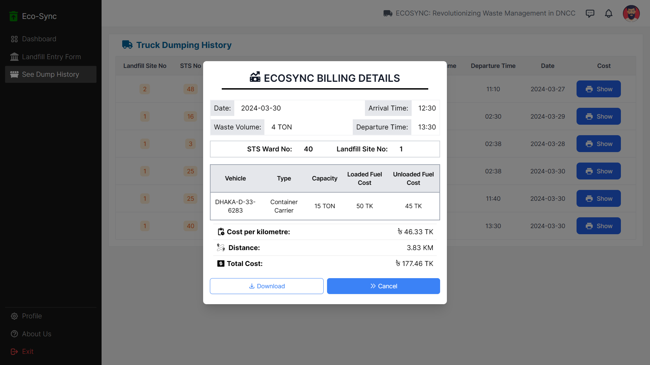
The landfill manager can generate a slip regarding fuel cost after each truck dumping entry

Slide 49
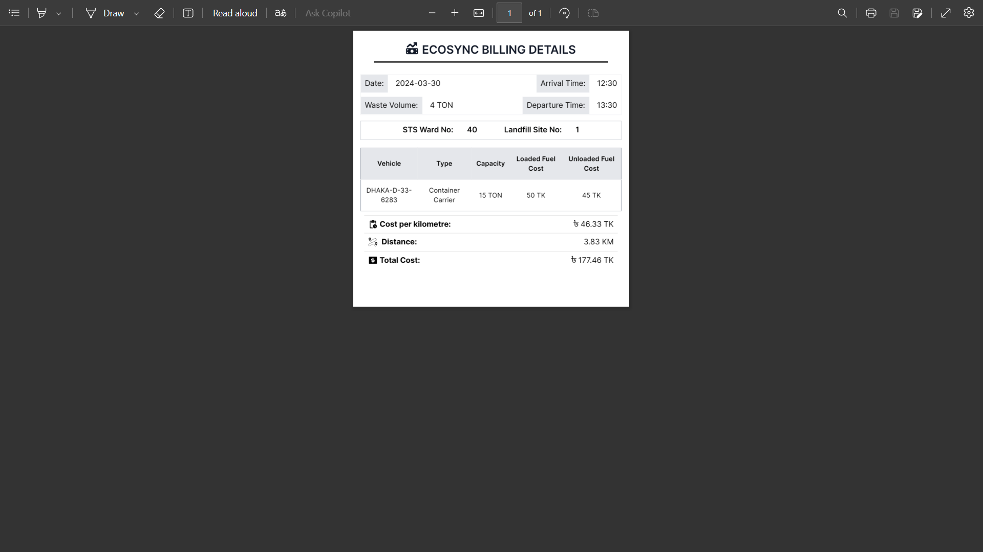
Landfill Manager can download bill’s slip as PDF

Slide 50
OTHER FEATURE

Slide 51
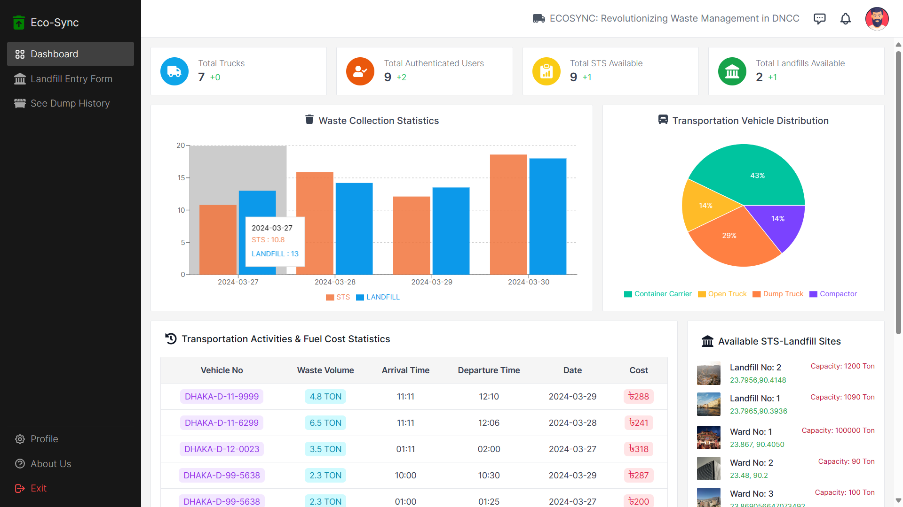
Dynamic Dashboard : Everything changes based on data entry

Slide 52

Reset Password Initial Page

Slide 53
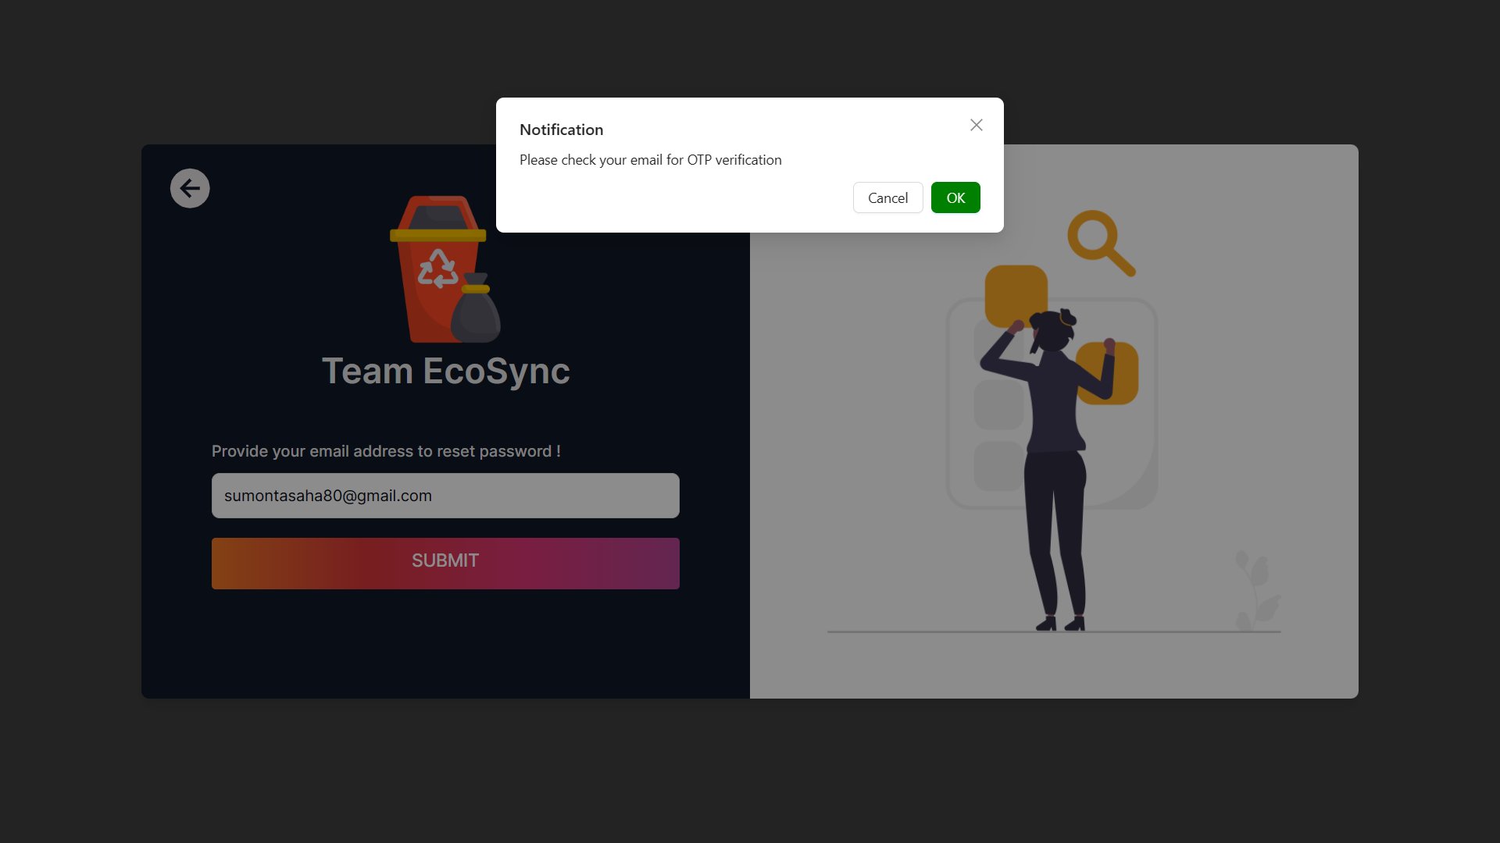
OTP Sent to User email for verification

Slide 54
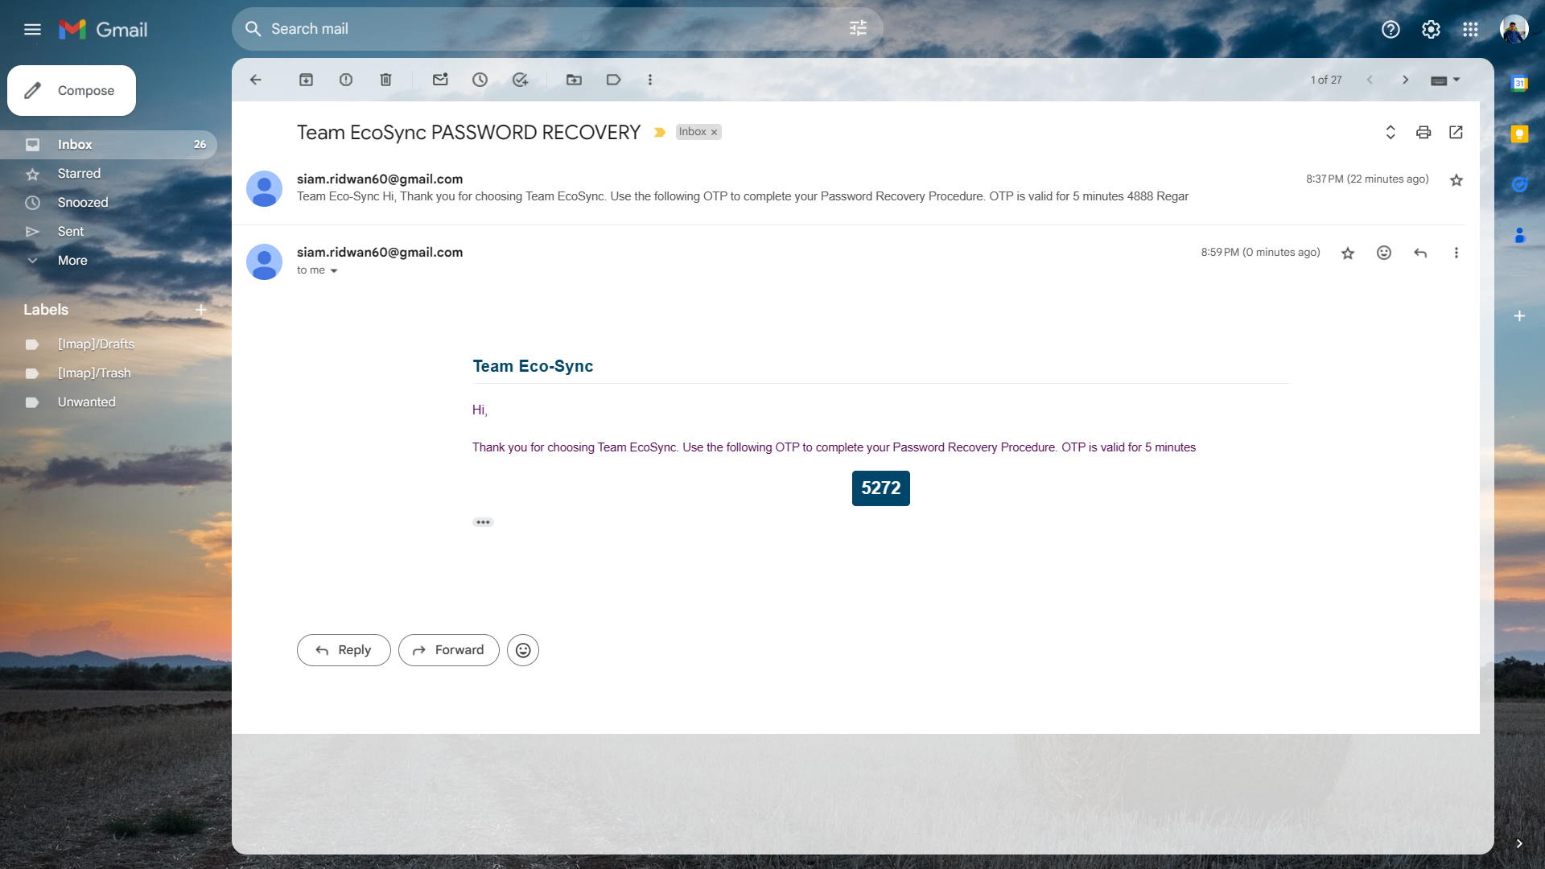
OTP in Email

Slide 55
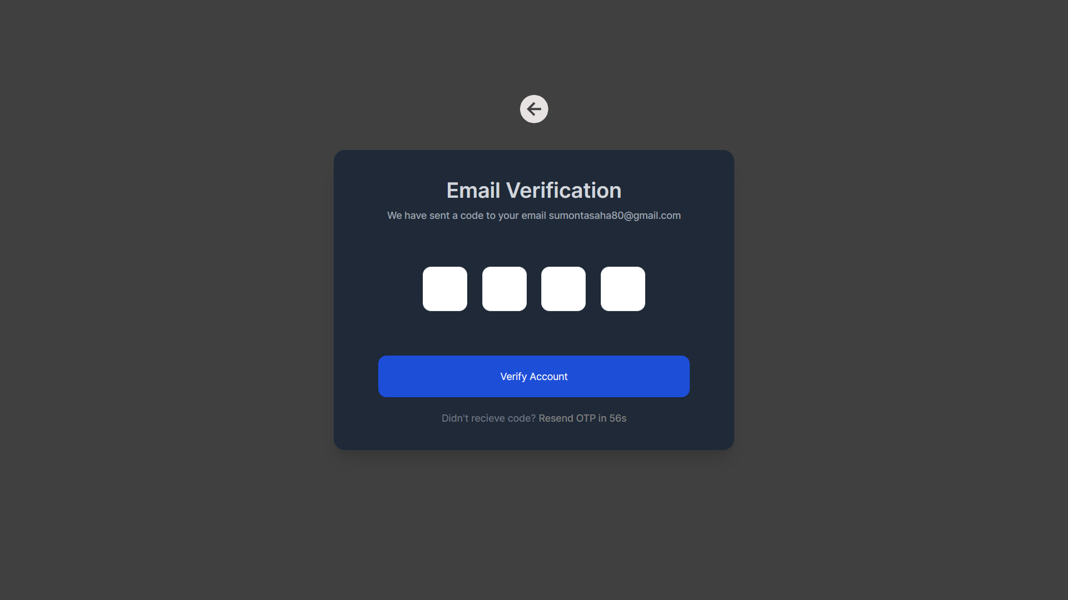
Account Verify Using OTP

Slide 56
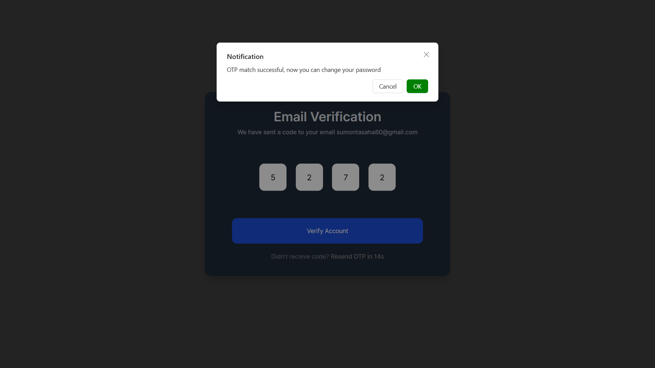
OTP Verification is Successful

Slide 57
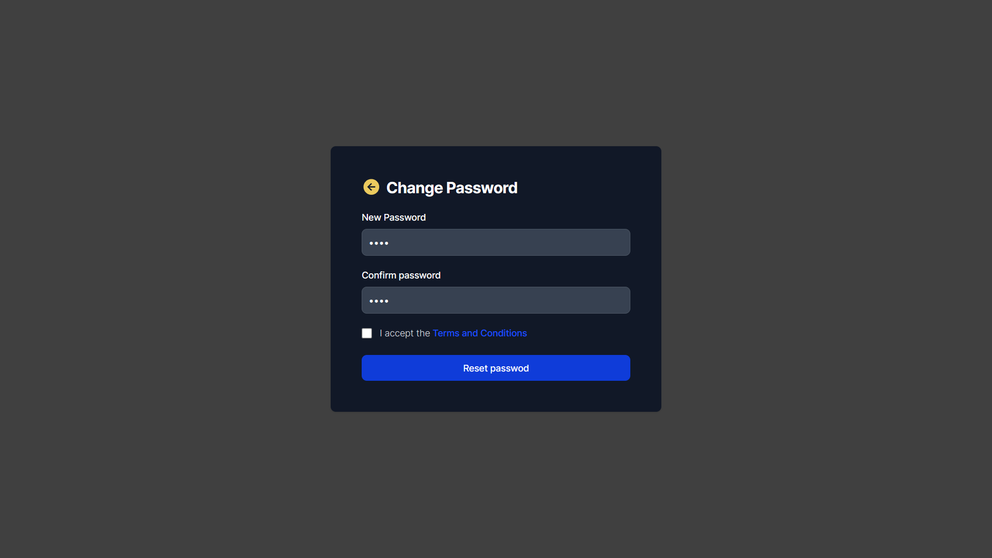
Now User can reset his password

Slide 58

Password Change is Successful

Slide 59

If Someone has not access to specific Permission

Slide 60




Step 2 : Currently the role has no Permission Access
Step 1 : Creating a New Role
Step 4 : Now the role has Dashboard
Access
Step 3 : Giving Only dashboard Access to that role

Slide 61



Step 2 : Giving the new Role
To the user
Step 1 : Role of the user
is Unassigned
Step 3 : Now the user Role is
SUB-STS-Manager

Slide 62


Now the user is Logged IN
Role of the user is : SUB-STS-Manager
Permission Access : Only Dashboard

Slide 63
THANK YOU

